Slide 1
FINA 1303 FINANCIAL REGULATION & MONETARY POLICY
Veronique Lafon-Vinais
Associate Professor of Business Education - Department of Finance

Slide 2
Course Map
Overview
Foundations of
Interest Rates
Financial Institutions
Pricing of Financial Assets
Regulations
DCF
Sell Side
Buy Side
Stock
Valuation
Banking Regulation
Basics of
Interest Rates
Commercial Banking
Traditional Institutional Investors
Monetary Policy
Investment Banking
Alternative Investors
2

Slide 3
Course Map
Overview
Regulations
Goals of Financial Regulation
Banking Regulation
Financial Regulation in Hong Kong
Banking Regulation
Monetary Policy
3

Slide 4
Class discussion
What are the objectives and goals of financial regulation?

Slide 5
Goals of Financial Regulation
Ensure adequate consumer protections.
Because financial institutions’ incentives to maximize profits can in some cases lead to sales of unsuitable or fraudulent financial products, or unfair or deceptive acts or practices, U.S. regulators take steps to address informational disadvantages that consumers and investors may face, ensure consumers and investors have sufficient information to make appropriate decisions, and oversee business conduct and sales practices to prevent fraud and abuse.
Ensure the integrity and fairness of markets.
Because some market participants could seek to manipulate markets to obtain unfair gains in a way that is not easily detectable by other participants, U.S. regulators set rules for and monitor markets and their participants to prevent fraud and manipulation, limit problems in asset pricing, and ensure efficient market activity.
Source: US GAO report on US Financial Regulation, Jan 2009

Slide 6
Goals of Financial Regulation (Cont)
Monitor the safety and soundness of institutions.
Because markets sometimes lead financial institutions to take on excessive risks that can have significant negative impacts on consumers, investors, and taxpayers, regulators oversee risk-taking activities to promote the safety and soundness of financial institutions.
Act to ensure the stability of the overall financial system.
Because shocks to the system or the actions of financial institutions can lead to instability in the broader financial system, regulators act to reduce systemic risk in various ways, such as by providing emergency funding to troubled financial institutions.
Source: US GAO report on US Financial Regulation, Jan 09
Notes:
1. Increase Information to Investors
A. Decreases adverse selection and moral hazard problems
B. SEC forces corporations to disclose information
2. Ensuring the Soundness of Financial Intermediaries
A. Prevents financial panics
B. Chartering, reporting requirements, restrictions on assets and activities, deposit insurance, and anti-competitive measures
3. Improving Monetary Control
A. Reserve requirements
B. Deposit insurance to prevent bank panics

Slide 7
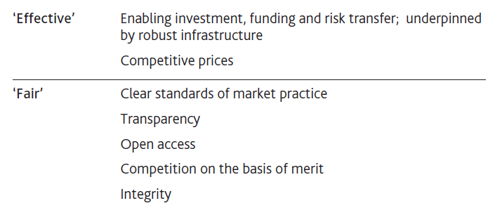
Fair and effective markets
Source: Bank of England - Fair and Effective Market Review -Oct 14
Notes:
Source: Bank of England Consultation on Fair and effective market review_Oct 14 http://www.bankofengland.co.uk/markets/Pages/fmreview.aspx and http://www.bankofengland.co.uk/markets/Documents/femr/consultation271014.pdf

Slide 8
Regulation of Financial Sector
Banking Authorities
Securities Regulators
Banks
Exchanges
Broker
Dealers
Self
Regulating
Industry
Bodies
Self
Regulating
Industry
Bodies
Fund
Managers
Laws
Insurance
Co

Slide 9
Financial Regulation in the US and Abroad
Major developed countries implement similar financial regulation
Financial reporting for corporations is required
Financial intermediaries are heavily regulated
There are different models of financial regulation and different approaches
Major characteristic of US financial regulation is the high number of regulatory agencies and the fragmentation of regulation of the financial industry
Notes:
Source: FT Lack of consensus dogs US regulators By Jeremy Grant http://www.ft.com/cms/s/0/b7e53ab6-5430-11dc-9a6e-0000779fd2ac.html Published: August 27 2007 03:00
Anyone looking for a case study of what is fragmented in the way the US regulates its financial services need only have been in a Chicago courtroom exactly a week ago. There, a judge hastily called a crisis hearing. At stake: a request by the Securities and Exchange Commission for a temporary restraining order related to Sentinel, an investment management company that caused ripples in global markets by revealing it was unable to meet client redemptions. It was a heated affair. However, far from witnessing seamless co-operation between the two main US financial watchdogs - the SEC and Commodity Fu-tures Trading Commission - the presiding judge was shocked to hear lawyers for each regulator take opposing views on the crisis surrounding Sentinel. "Why doesn't this agency of the government go over and talk to this [other] agency of the government and get your act together, for crying out loud," said Judge Matthew Kennelly, according to a transcript.
The case shows that, even as hundreds of millions of dollars were at stake in one of the largest collapses of an investment company, these US regulators were unable to agree a common approach to a crisis that, at one point, had global dimensions. The case could fuel recent calls for an overhaul of financial regulation in the US. High-level reports on the threats to New York as a financial centre have highlighted what they see as a weakness of the US system: too many regulators often with contradictory agendas, rooted in different congressional mandates. Indeed, some have held up the UK‘s Financial Services Authority, where regulation is under one roof, as a model. In the Sentinel case, the CFTC's priority was to preserve the integrity of the futures markets, which it regulates. But the SEC, which regulates securities firms, investment managers and brokers, was focused on investor protection. The agendas clashed, with painful consequences for some hedge funds.
Source: FT Bankruptcy trustee to take control at Sentinel By Jeremy Grant in Washington http://www.ft.com/cms/s/0/dec3d644-51c2-11dc-8779-0000779fd2ac.html Published: August 23 2007 22:57
The collapse of the Chicago-based firm caused ripples in global credit markets.
It has become a test of the ability of the two main financial regulators – the Securities and Exchange Commission and Commodity Futures Trading Commission – to work together in tackling a financial crisis involving an entity that is overseen by both. Some investors with funds at Sentinel have complained that other funds holders, mostly futures brokers, were compensated for their losses before them, as futures regulators rushed to head off any disruption to the futures industry. A bankruptcy judge in Chicago granted Sentinel’s request that its affairs be handed to a trustee, yet to be named, so that its accounts could be clarified before any further disbursement of funds was possible to creditors. Sentinel was this week hit with an SEC lawsuit alleging that it fraudulently moved $460m of clients’ funds to its own “house” account.

Slide 10
Governance and Compliance…
…THEN
…and NOW
Industry specialization
National boundaries
Early days of computers and internet
Relatively simple, “one size fits all” models of banking regulation – Basel I
National regulators vs. global finance
Principles vs. rules based regulation
Single vs. multiple regulators
Stakeholders vs. shareholders
Catch me if you can: regulation and financial innovation – impact of current crisis?

Slide 11
Regulatory Pendulum: CRIC
Who’s to blame?
Response
Improvement
Crisis
Complacency

Slide 12
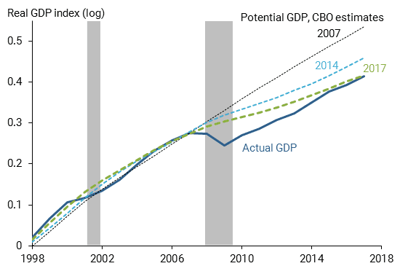
Cost of the GFC
Source: Bloomberg 15 Aug 18
Notes:
Source: Bloomberg 15 Aug 18 Barry Ritzhold https://mail.google.com/mail/#inbox/16538815c74a9709?projector=1

Slide 13
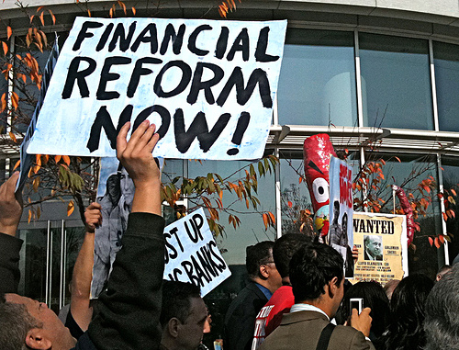
Effect of the GFC

Slide 14

…not that easy
Notes:
Source:

Slide 15
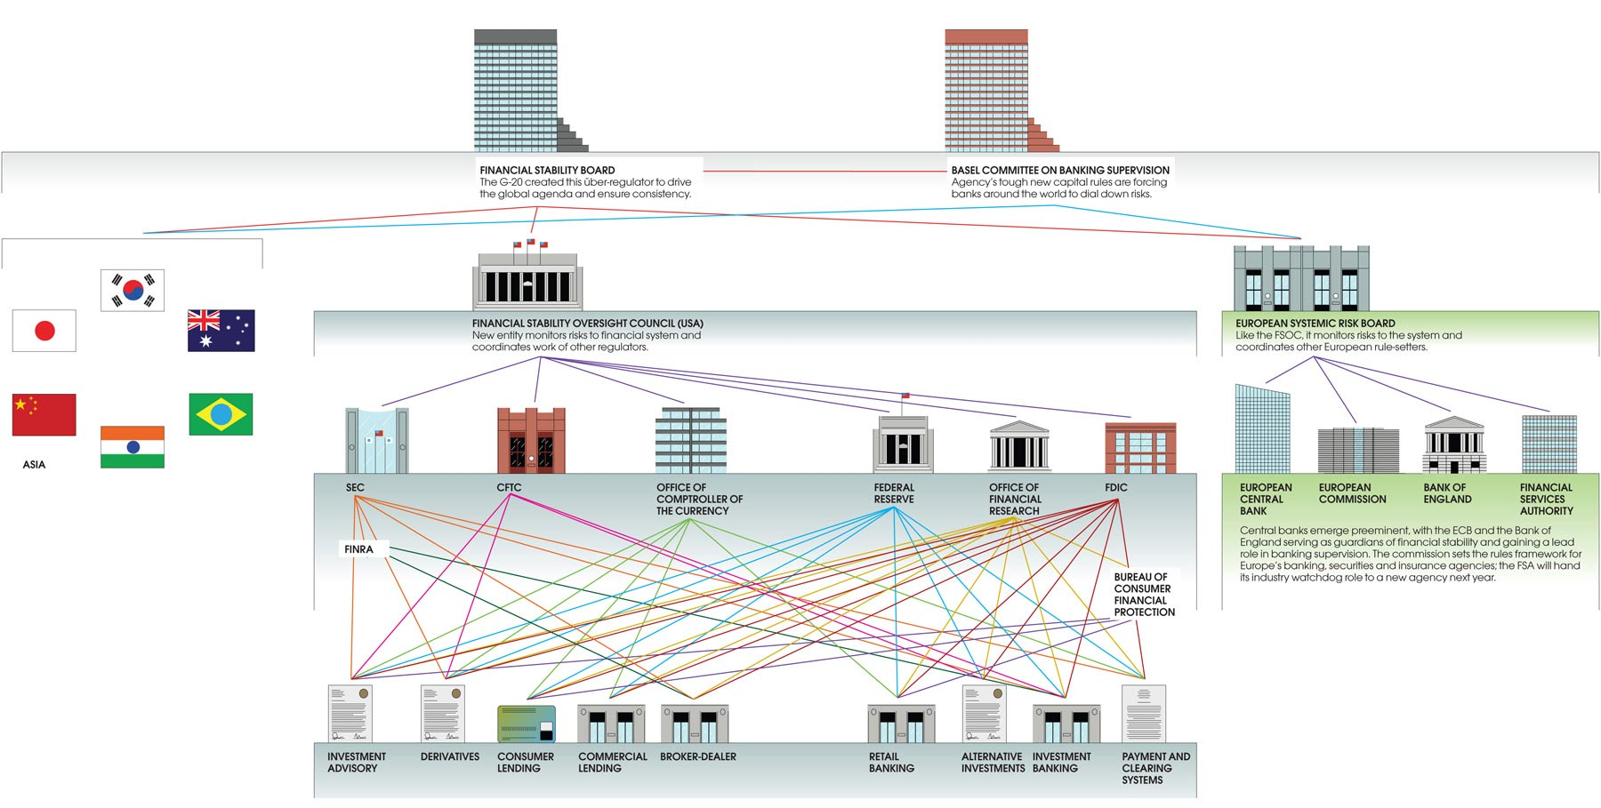
The regulatory landscape
Source: Institutional Investor Sept 12
Notes:
Source: Institutional Investor Sept 12 http://www.institutionalinvestor.com/Article/3088137/New-Rules-Old-Risks.html

Slide 16
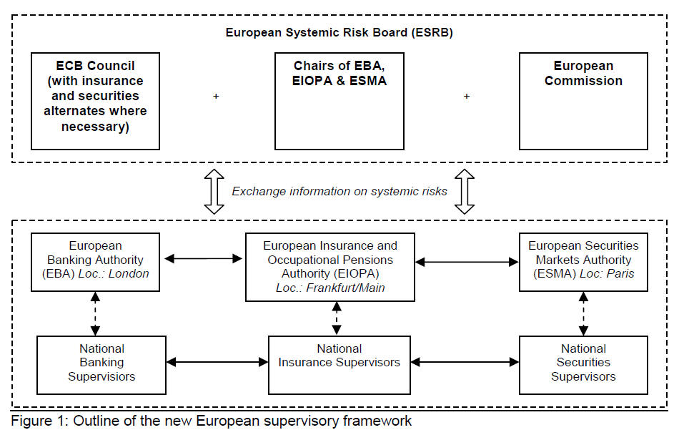
EU financial supervision framework
The European Authorities have the power to: - draw up specific rules for national authorities and financial institutions; - develop technical standards, guidelines and recommendations. - monitor how rules are being enforced by national supervisory authorities (NSAs) - take action in emergencies, including the banning of certain products; - mediate and settle disputes between national supervisors, - ensure the consistent application of EU law, and - where necessary, the new Authorities have the possibility of settling disagreements between national authorities, in particular in areas that require cooperation, coordination or joint decision-making by supervisory authorities from more than one Member State.
Source: ESRB
Notes:
Source: ESRB http://european-systemic-risk-board.com/European_Systemic_Risk_Board_2.html

Slide 17
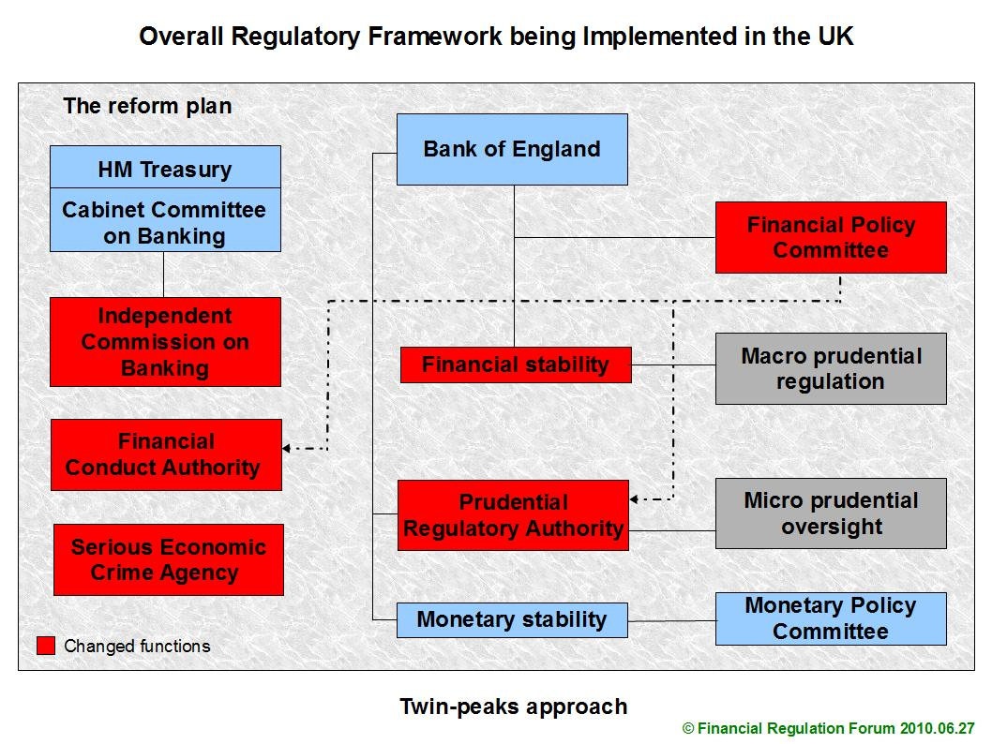
Notes:
Source: http://www.financialregulationforum.com/wpmember/e-learning-interactive-graphic-the-new-uk-twin-peaks-regulatory-structure-6486/
The current system – which shares responsibility for financial stability between the Treasury, the Bank of England and the Financial Services Authority (FSA) – is being replaced with a new system, and the FSA will cease to exist in its current form. The legislation to implement the reforms will establish a Financial Policy Committee (FPC) in the Bank of England with a dedicated focus on identifying and managing macroeconomic and other risks to the stability of the financial services sector. It will also create a new Prudential Regulation Authority (as a subsidiary of the Bank of England), responsible for the day-to-day prudential supervision of financial institutions, and a Financial Conduct Authority (FCA) with responsibility for the conduct of all financial services firms.

Slide 18
Snapshot of Dodd-Frank Act 2010
In reforming the financial system, the Dodd-Frank Act introduces new regulators and extends regulation over new markets, entities, and activities.
Regulators get expanded authority to define which financial firms are systemic — those which by their size, scope, and interconnectedness with other institutions can pose risks to the entire system.
Corporate end-users should monitor the development of rules on over-the-counter derivatives that could affect their hedging activities.
The Act emphasizes stronger consumer and investor protections and begins to address the orderly resolution of large failures in ways that limit losses to taxpayers.
Source: PWC – 10 minutes on US Financial Reform – July 2010

Slide 19
Snapshot of Dodd-Frank Act 2010
Source: PWC – 10 minutes on US Financial Reform – July 2010
Notes:
Source: http://www.pwc.com/us/en/10minutes/assets/10-minutes-on-us-financial-reform.pdf
The Wall Street Reform and Consumer Protection Act (the Dodd-Frank Act or the Act) 2010

Slide 20
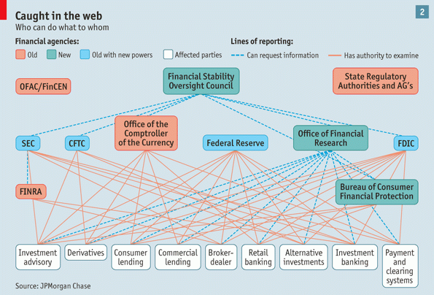
US financial industry regulatory web
Notes:
Source: The Economist

Slide 21
Global Regulation
The long arm of US law:
Issues with Patriot Act: the case of Banco Delta Macau
Issues with jurisdictional choice: US as “global court” with the “f-cubed” concept
Issues with FCPA/extradition treaties: the case of the Nat West Three
Conflicts with foreign laws: FATCA (secrecy laws v. US Revenue) , the case of Deloitte China (SEC v. China secrecy laws)
“f-cubed” concept: US courts use the “conduct and effects” test to accept jurisdiction over cases where foreign shareholders sue foreign companies whose shares were traded primarily through foreign exchanges
Notes:
Source: Shrinking World Litigious European investors are multiplying, but the U.S. continues to hang onto its status as a "global court." Tony McAuley and Jason Sumner, CFO Europe December 12, 2006 http://www.cfo.com/printable/article.cfm/8405103/c_2984288?f=options
Are European shareholders closing the gap in terms of legal redress against wayward management, or is the US firming up its status as a kind of “global court” for class actions? For Ralph Stone, partner in Shalov, Stone & Bonner, the scales are tipping towards Europe. “There is an erosion of investor rights in the US at precisely the time the Europeans are enhancing them,” he says. Stone points to developments in several European countries, including German corporate law reform and findings by the German Federal Court (BGH) on cases involving fraud by companies listed on the now-defunct Neuer Markt, which have helped define shareholders’ legal rights.
However, Europe remains untested compared with the US. German law extending shareholders’ access to courts (UMAG) sets high thresholds—for example, shareholders must try to induce the supervisory board to sue before they apply to court. The law is “aimed to avoid a lawyer-driven stream of corporate litigation with doubtful benefits for shareholders as exists in the US,” according Ulrich Noack, a law professor at Heinrich Heine University in Dusseldorf.
For similar reasons, “the judgments of the BGH don’t open the gates for lawsuits from dissatisfied investors,” according to Dirk Reidenbach, a researcher at the Banking Law Institute, Goethe University in Frankfurt.
Also, notwithstanding rumblings about tort reform and talk in November from the new US Treasury secretary, ex-Goldman Sachs CEO Henry Paulson, about the need to move from a hyper-legal approach to a more “prudential” system, the US is still the legal destination of choice for shareholders and other aggrieved parties.
This is borne out by the latest international litigation figures from law firm Fulbright & Jaworski, which show that a quarter of non-US companies surveyed had class actions pending against them in the US in 2006, up from just 6% in 2005.
For shareholder class actions, a record was set early in 2006 with the $1.1 billion (€800m) settlement by Dutch retailer Royal Ahold, “in what will surely be chilling news to non-US issuers already wary of being embroiled in US litigation,” according to a report by National Economic Research Associates, a New York consulting firm.
Indeed, US courts have extended the “f-cubed” concept, whereby they accept jurisdiction over cases where foreign shareholders sue foreign companies whose shares were traded primarily through foreign exchanges. Important precedents were set in the New York federal court, where judge Lewis Kaplan has defined “conduct and effects” tests that determine US jurisdiction in suits against advisors and bankers to failed Italian dairy company Parmalat. The concept of a “worldwide class” of shareholder will be further tested in 2007.
As Lista Cannon, London senior partner in Fulbright & Jaworski, points out, “Increasingly, judges are recognising that while US securities laws may not expressly permit foreign shareholders to sue, applying the conduct and effects tests in the world of global business may well provide a proper basis for US jurisdiction.”
US market regulator revises its foreign policy
Source: Jeremy Grant, Financial Times, Published: 15.03.2007
When Charlie McGreevy, European Union internal markets commissioner, stepped inside the glass atrium of the securities and exchange commission's headquarters in Washington yesterday, he was treading a path to the world's most powerful market regulator well worn by foreign officials. But instead of coming as an outsider, he and the other European officials in town for annual meetings with us regulators and bankers were here as increasingly valued equals. That is because a subtle, but significant, shift has taken place in the sec's attitude to the outside world in the past year. One sign is that sec staff members are pushing a radical idea: that foreign brokers and exchanges would no longer have to submit to sec regulation to service clients in the us. Instead, the commission might be prepared to rely on overseas regulators to oversee foreign brokers and exchanges as they sought to service clients in the us. If adopted, the idea would break with the last 74 years of sec policy towards us investor protection, forged in the post-wall street crash years of the 1930s. For years, there was little need to deal with foreign jurisdictions as stock trading was overwhelmingly a national affair. But the us investors' appetite for foreign assets, cross-border stock-exchange consolidation and advances in trading technology that have all but eliminated physical barriers to global market access have convinced many decision makers at the sec that collaboration, not isolation, must guide sec policy.
A flurry of co-operation deals have been struck with foreign regulators, from china to the UK's financial services authority. Christopher Cox, sec chairman, has stressed the need for regulators to work together - a marked change for one that was often perceived as dealing only reluctantly with its foreign counterparts. The development will be welcomed by businesses and regulators abroad, many of which have occasionally felt treated as second-class citizens by the sec. Harvey Pitt, a former sec chairman, says: "i think what we're clearly seeing is a very enlightened view of the need for global cooperation and the recognition that the us, which has been and remains a leader in principles of market regulation, is not the only country with a handle on how regulations should proceed." Susan Milligan, senior vice-president of government relations at the options clearing corporation, which clears trades for the six us options exchanges regulated by the SEC, welcomes the shift: "previously, there was a wall and a big moat around the united states." Recent months have seen plenty of action backing up the shift, as evidenced by the globe-trotting of the Mr. Cox. He admits the "imperative of rapid globalization has forced me to conduct my responsibilities far differently than my predecessors". In December, the sec addressed a long-standing bone of contention for non- us companies by making it easier for them to delist from us stock exchanges and deregister from the sec, thus escaping Sarbanes-Oxley. The same month, fresh guidance emerged on Sarbanes-Oxley that should make it easier for us and foreign companies with us listings to implement its contentious section 404 clause.
However, the biggest impetus for the changed thinking at the sec has come as a result of the recent purchase of euronext-liffe, the pan-european stock and derivatives exchange, by the New York stock exchange, and the failed bid for the London Stock Exchange by NASDAQ. This led to a flurry of contact between us and European regulators as they figured out how regulators should respond to the prospect of exchanges operating across multiple time zones. For Mr. Cox, the events were "significant manifestations of this shrinking world". He says that two years ago there was "very little focus on the integration of securities exchanges across borders, or the impact of the 'retailisation' of international investment, or the consequences of international cybercrime for securities law enforcement". He warns that in an environment in which investors can easily choose where they want to trade, governments face strains on their ability to impose securities regulations. "It is the job of national regulators to wade into this fray - to protect investors, and to promote the market integrity that capital formation depends upon. We really have no choice. After all, there's no global regulator who can do the job for us." Some question whether the sec's motives in leading the charge towards more regulation convergence are driven by a desire to ensure the us has a stake in getting its standards adopted abroad. However, Mr. McGreevy sees a lesson in the shift for Europe. "It is very important for Europe to be able to get our own house in order. We have great difficulty getting harmonization of regulations among our 27 member states. I think it is heartening to see what is happening in the us."

Slide 22
International organisations concerned with financial stability
Basel Committee on Banking Supervision – est. 1975; Objective: supervision of international banks
International Organisation of Securities Commission (IOSCO) - from 1990; objective: supervision of securities firms
International Association of Insurance Supervisors (IAIS) – est. 1974; objective: supervision of insurance firms
International Accounting Standards Committee (IASC) – est. 1973; objective: harmonize accounting rules worldwide; set up IASB to implement global standards
International Accounting Standards Board (IASB) – est. 2001; objective: implement a set of global accounting standards
Financial Stability Forum (FSF) – est. 1999; objective: identify & take action on vulnerabilities in international financial system; improve coordination, information flows between members
Source: Heffernan
Notes:
Source: Modern Banking, Shelagh Heffernan, 2005 Wiley

Slide 23
SUMMARY
Goals of financial regulation
Regulation framework of the financial sector
CRIC
Financial supervision/regulatory framework in EU & UK
Key regulators
Dodd-Frank Act 2010
f-cubed concept

Slide 24

Test Your Understanding
Which US regulator oversees systemic risk?
The Fed
The SFC
The FSOC
The FSB
Which is its equivalent in the EU?
ECB
ESMA
ESRB
Which entity overlooks banking capitalisation rules?
FSB
BCBS

Slide 25
Course Map
Overview
Regulations
Goals of Financial Regulation
Banking Regulation
Financial Regulation in Hong Kong
Banking Regulation
Monetary Policy
Spring 10

Slide 26
Basic Categories of Banking Regulation
Bank supervision: Licensing/chartering and bank examination
Disclosure requirements & Consumer protection
Restrictions on asset holdings
Restrictions on competition
Prudential ratios:
Liquidity & reserve requirements
Capital requirements (Basel guidelines)
Government safety net
Deposit insurance
Lender of last resort

Slide 27
Bank Supervision: Chartering and Examination
Chartering and licensing reduce adverse selection by making it more difficult for crooks to set up banks
US: different types of charters (national/state)
Bank examination and on-site visits reduce moral hazard by verifying information provided
CAMELS ratings
Focus on processes and new emphasis on risk management: 4 elements of risk management and control:
Quality of board and senior management oversight
Adequacy of policies limiting risk activity
Quality of risk measurement and monitoring
Adequacy of internal controls to prevent fraud
In the US banks are regulated through a dual banking system:
both federal and state authorities have significant regulatory powers
Notes:
Reduces the adverse selection problem of risk-takers or crooks owning banks to engage in highly speculative activities. Charters may simply not be granted.
Dual banking system: national banks are regulated at the federal level by the OCC; state banks are regulated by the state banking authorities. In addition the Fed has regulatory authority over state member banks
Examinations assign a CAMEL rating to a bank, which can be used to justify cease and desist orders for risky activities.
Period reporting (call reports) and frequent (sometimes unannounced) examinations allow regulators to address risky / questionable practices in a prompt fashion.
Restrictions on Entry
Regulators have created very tight regulations as to who is allowed to set up a financial intermediary
Individuals or groups that want to establish a financial intermediary, such as a bank or an insurance company, must obtain a charter from the state or the federal government
Only if they are upstanding citizens with impeccable credentials and a large amount of initial funds will they be given a charter.
In the US, the system was designed to give the states closer control over industries operating within their borders, but also, through federal legislation, to ensure that banks would be treated fairly by individual states and local communities as their activities expanded across state lines.
Guidelines for the management of interest rate risk:
Bank board of directors required to establish interest rate risk limits
Board has to appoint officials of the bank to manage interest rate risk
Board has to monitor the IR risk exposure
Senior management has to develop formal risk management policies and procedures to ensure that the board’s risk limits are not violated and to implement internal controls to monitor IR risk and compliance with the board’s objectives

Slide 28
Bank Supervision
CAMELS Ratings
Capital Adequacy
Asset Quality
Management
Earnings
Liquidity
Sensitivity to Risk
If CAMELS rating is too high, the bank regulators can issue a “cease and desist” order to the bank to change its behavior, or close the bank
Bank examiners give a separate risk management rating (1 (best) to 5 (worst)) that feeds into the overall management rating as part of the CAMELS system
Why do banks care about CAMELS ratings? Deposit insurance premiums are based on CAMELS; poor ratings lead to closer monitoring by the regulators
Notes:
Bank examiners carry unannounced on-site visits. Depending on findings, a bank can be pronounced “problem bank”subject to close monitoring and frequent examination
The components of a bank's condition that are assessed:
(C)apital adequacy
(A)ssets
(M)anagement Capability
(E)arnings
(L)iquidity (also called asset liability management)
(S)ensitivity (sensitivity to market risk, especially interest rate risk)
Ratings are given from 1 (best) to 5 (worst) in each of the above categories.
The rating system is designed to take into account and reflect all significant financial and operational factors examiners assess in their evaluation of an institutions performance. Institutions are rated using a combination of specific financial ratios and examiner qualitative judgments.

Slide 29
Disclosure Requirements & Consumer Protection
Disclosure Requirements
Better information reduces both moral hazard and adverse selection problems
Stringent reporting requirements for financial intermediaries
Their bookkeeping must follow certain strict principles,
Their books are subject to periodic inspection,
They must make certain information available to the public.
Consumer Protection
“Truth in Lending” Consumer Protection Act 1969 and Fair Billing Act 1974 → full disclosure of exact financing terms on comparable basis (annual percentage rate APR)
Equal Credit Opportunity Act 1974/1976 and Community Reinvestment Act 1977 → Prevent discrimination and “redlining”
Regulation Z
Regulation B
Under Pdt Trump, these restrictions have been loosened under bank lobbying influence
Notes:
Disclosure requirements:
Regulators require that banks adhere to certain standard accounting principles and disclose a wide range of information to help the public assess the risk of the banks’ porfolio and sum of banks’ exposure to risk
Consumer protection:
Truth in Lending” Consumer Protection Act 1969 requires all lenders to provide information to consumers about the cost of borrowing inclusive of a standardized interest rate (annual percentage rate APR) and total finance charges for the loans
Fair Billing Act 1974 requires creditors, specially credit card issuers, to provide information on the method of assessing finance charges and requires that complaints be handled quickly
Equal Credit Opportunity Act 1974/1976 forbids lenders to discriminate based on race, gender, marital status, age or national origin
Community Reinvestment Act 1977  Prevent “redlining” e.g. lenders refusing to lend in a particular geographic area  banks are required to lend in all areas in which they take deposits

Slide 30
Restrictions on Competition
Branching restrictions, which reduced competition between banks
Limits on interstate branching
Separation of banking and securities industries: Glass-Steagall Act
In other words, preventing nonbanks from competing with banks
Source: Mishkin/Eakins
Notes:
Although the evidence that unbridled competition among financial intermediaries promotes failures that will harm the public is extremely weak, it has not stopped the state and federal governments from imposing many restrictive regulations.
In the past, banks were not allowed to open up branches in other states, and in some states banks were restricted from opening additional locations.
Competition has also been inhibited by regulations that impose restrictions on interest rates that can be paid on deposits.
These regulations were instituted because of the widespread belief that unrestricted interest-rate competition helped encourage bank failures during the Great Depression.
Later evidence does not seem to support this view, and restrictions on interest rates have been abolished.

Slide 31
Restriction on Assets Holdings
Restrictions on banks’ assets holdings and activities are designed to reduce moral hazard by preventing banks from engaging in risky activities
Types of restrictions include:
Restrictions on holding certain assets
E.g. holdings of common stock of non financial companies
Concentration and diversification rules and prudential ratios
E.g. limits on how exposure a bank can take on a single customer
Notes:
There are restrictions on what financial intermediaries are allowed to do and what assets they can hold.
Before you put your funds into a bank or some other such institution, you would want to know that your funds are safe and that the bank or other financial intermediary will be able to meet its obligations to you
One way of doing this is to restrict the financial intermediary from engaging in certain risky activities
Another way is to restrict financial intermediaries from holding certain risky assets, or at least from holding a greater quantity of these risky assets than is prudent

Slide 32
SUMMARY
basic categories
chartering and examination
CAMELS ratings
Regulations Z/B
Glass-Steagall

Slide 33
Test Your Understanding
CAMELS ratings are used in:
Bank licensing
Bank chartering
Bank examinations
In the US, Reg Z is intended to:
Protect the banks from default
Protect customers against discrimination
Provide customers with easily comparable information

Slide 34
Prudential ratios - liquidity & reserve requirements
Banking authorities may require banks to maintain certain prudential ratios such as liquidity ratio, capital adequacy ratio, reserve requirement and others (for example, concentration limits)
Liquidity requirements: Most regulators require some form of liquidity or reserve requirements such as:
Reserve requirement : in the US, banks are required to hold 10% of the amount of transaction deposits in cash or in reserves at the Fed
Liquidity ratio: in Hong Kong, there is no reserve requirement but banks have to maintain Basel III’s liquidity ratios (LCR and NSFR)
This requirement was suspended due to the pandemic

Slide 35
Prudential ratios - capital requirements
Banks are required to hold a certain level of capital (book equity) that depends on the type of assets that the bank holds
Reduces moral hazard
In the US, higher capital means more collateral for FDIC
3 types of capital requirements in US:
Leverage ratio = bank capital/total assets >5%
Capital adequacy ratio (BIS or Basel I/ II/III… ratio) = capital/ (total risk weighted assets & other risk-related exposure) >8% with “core” (or Tier 1) capital > 4%
Capital requirement on trading activities (Basel 1996 Market Risk Amendment) for banks engaging in such => based on banks’ own models, calculate max loss over ten day period and provide additional capital (Tier 3) covering 3 times that amount.
In the US banks are classified into 5 groups based on their CAR. FDIC has to take prompt corrective action for groups 3 - 5
Notes:
Banks are also subject to capital requirements
Banks are required to hold a certain level of capital (book equity) that depends on the type of assets that the bank holds
Reduces moral hazard: banks have more to lose when have higher capital (bank capital prevents bank failure)
In the US, higher capital means more collateral for FDIC (since FDICIA => higher capitalized banks allowed more flexibility in pursuit of new activities)
3 types of capital requirements in US:
leverage ratio = bank capital/total assets >5%
CAR (Basel I) capital adequacy ratio (BIS ratio) = capital/(total risk weighted assets & other risk-related exposure) >8% with “core” (or Tier 1) capital > 4%
capital requirement on trading activities for banks engaging in such => based on banks’ own models, calculate max loss over ten day period and provide additional capital (Tier 3) covering 3 times that amount.
Capital Adequacy Management
Bank capital is a cushion that prevents bank failure
Amount of K affects returns to shareholders: higher is bank capital, lower is return on equity
ROA = Net Profits/Assets
ROE = Net Profits/Equity Capital
EM = Assets/Equity Capital
ROE = ROA x EM
Capital ↑, EM ↓, ROE ↓
Banks need to hold capital to meet capital requirements
Strategies for Managing Capital:
Sell or retire stock
Change dividends to change retained earnings
Change asset growth
Group 1 = well capitalized; well exceed CAR=> these banks earn privileges such as insurance on brokered deposits and ability to do securities underwriting
Group 2 = adequately capitalized
Group 3 = undercapitalized, banks don’t meet CAR, FDIC has to take prompt corrective action measures e.g. require bank to submit capital restoration plan, restrict asset growth, seek regulatory approval to open new branches or new lines of business
Group 4 = severely undercapitalized; serious measures have to be taken; not allowed to pay interest on deposits at rates higher than average
Group 5 = critically undercapitalized; not allowed to pay interest on deposits at rates higher than average; FDIC has to take steps to close down the bank

Slide 36
Calculating the Leverage Ratio
Leverage Ratio = Capital/Assets
= $7m/$100m
= 7%
Bank is well capitalized
Total assets
$ 100 m
Source: Mishkin/Eakins

Slide 37
Capital Structure and BIS Ratio (Basel I)
Core
Capital
Tier 1 no less than 4%
Tier 2
Tier 3 (market risk)
Debt
at least 8%
Notes:
For regulatory purposes international regulators have divided a bank’s capital into three tiers, reflecting the extent to which instruments meet the key underlying principles of capital, loss absorbency and permanence.
Tier 1 is the highest quality form of capital and so can be included without limit in a bank’s capital for regulatory purposes. Tier 2 and Tier 3 capital include features that conform less closely with the underlying principles and are therefore limited to a proportion of the Tier 1 held.
Innovative Tier 1 instruments (which were only partly defined by Basel) are limited to 15% of total Tier 1 capital. As banks have moved closer to their limit of 15% in innovative Tier 1 instruments, the focus has increasingly turned to the boundary between non-innovative (core) and innovative Tier 1.
Tier 3 capital was created by the Basle Committee on Banking Supervision to provide capital cushion for the price risks to which banks are exposed, particularly those arising from their trading activities. To qualify as tier 3 capital, securities must be subordinated, unsecured, and subject to a minimum maturity of two years. They are not repayable prior to maturity without the consent of regulators. Also, they are subject to a 'lock-in' clause that allows regulators to prevent payment of interest and principle if payment would cause the issuing bank to fall below minimum capital requirements. In analyzing tier 3 issues of highly rated banks ('AA' category or better), Fitch expects there to be little or no rating differential between existing subordinated debt and new tier 3 issues. For institutions of lower credit quality ('A' or lower), Fitch may place a wider gap between senior credit ratings and tier 3 ratings, due to a higher probability of the lock-in being invoked and the possibility of ultimate default.

Slide 38
Capital Adequacy Ratio “BIS ratio” Basel I
Banks in all participating nations must have a minimum Capital Adequacy Ratio (CAR) of total capital to sum of risk-weighted assets and other related risk-exposed items of 8%
CB = Capital Base
RWA = Risk Weighted Assets
Notes:
Two components to denominator:
Risk-weighted assets and
Risk-weighted off-balance sheet items
RWA:
Total risk-weighted assets (on bank’s balance sheet) + total risk-weighted off-balance sheet items
Risk-weighted assets are to be determined by classifying each of a bank’s assets listed on its balance sheet into four categories based on each asset’s degree of risk exposure and multiplying the volume of assets in each category by a fractional risk weight ranging from 0 to 1.
Off-balance sheet commitments are first assigned a credit-equivalent percentage that converts them to on-balance sheet items and then assigned into the same four categories of risk weighting.
Examples of off balance sheet commitments: SBLCs, undrawn committed facilities and lines of credit, loans sold with recourse, derivatives

Slide 39
Capital Adequacy Ratio “BIS Ratio” Basel I (Continued)
Tier 1 or “core” (permanent) capital
Tangible equity including common stock +
Non cumulative preferred stocks + other hybrid equity instruments +
Surplus plus retained earnings +
Minority interest in consolidated subsidiaries+
Capital reserves less intangibles
Tier 2 or “supplemental” capital (Upper Tier 2 and Lower Tier 2)
Subordinated capital notes & debentures > 5 years to maturity +
Limited-life preferred stock + cumulative perpetual preferred stock
Loan loss reserves
Notes:
A. Tier 1 capital, including:
Common stockholder’s equity
Noncumulative perpetual preferred stock
Capital reserves (except the appreciation reserves of fixed assets)
Retained earnings (deducting the insufficiency of operation reserves and loan loss provisions)
Minority interest
Cumulative effect of equity adjustments
Less: goodwill and treasury stock
B. Tier 2 capital, including:
Cumulative Perpetual preferred stock
Appreciation reserves of fixed assets
45% of unrealized holding gains of long-term equity investments
Operation reserves
Convertible debt securities
Allowance for loan and lease losses (except the reserves created against identified losses)
Long-term subordinated debt and long-term non-perpetual preferred stock

Slide 40
Capital Adequacy Ratio “BIS ratio” Basel I (Continued)
Risk Weights | Four Categories
0.00 | Items that have little default risk e.g. cash; OECD government securities
0.20 | Some degree of minimal risk e.g. other types of government securities; claims on banks in OECD countries; interbank deposits
0.50 | Secured/collateralized loans e.g. residential mortgage loans, government revenue bonds, selected types of mortgage-backed securities
1.00 | Maximum degree of risk e.g. commercial and consumer unsecured loans and other assets of the highest risk exposure
Notes:
Korea is OECD, HK and Singapore are not.

Slide 41
Capital Adequacy Ratio “BIS ratio” Basel I (Continued)
Off balance sheet instruments such as:
Letters of credit
Futures
Swaps
FX agreements
Are converted into “credit risk equivalents” and weighted by the type of counterparty to a given claim according to the risk weight categories (e.g. OECD governments : 0%)

Slide 42
Calculating the BIS Ratio (Basel I CAR)
Assets |  | Liabilities
Reserves | $ 3 m | Checkable deposits | $ 20 m
Treasury securities | $ 10 m | Non transactions deposits | $ 60 m
Gov. agency securities | $ 7 m | Borrowings | $ 11 m
Municipal bonds | $ 10 m | Loan loss reserves | $ 2 m
Residential mortgages | $ 10 m | Bank capital | $ 7 m
Real estate loans | $ 20 m
C&I loans | $ 35 m
Fixed assets | $ 5 m
Total Assets | $ 100 m | Total Liabilities and Equity | $ 100m
Off balance sheet: SBLC $ 20 million
Source: Mishkin/Eakins

Slide 43
Calculating Risk-Adjusted Requirements
Little default risk: 0%
Risk Adjusted Assets =
0 x $ 3 million (Reserves)
+ 0 x $10 million (Treasury securities)
+ .20 x $ 7 million (Agency securities)
+ .50 x $10 million (Municipal bonds)
+ .50 x $10 million (Residential mortgages)
+1.00 x $20 million (Real estate loans)
+1.00 x $35 million (Commercial loans)
+1.00 x $ 5 million (Fixed assets)
+1.00 x $20 million (SBLCs)
$91.4 million (Total risk-adjusted assets)
Other type of government securities: 20%
Secured/ collateralized loans: 50%
Unsecured loans: 100%
Notes:
Source: Mishin/Eakins
The first step is to allocate each of the assets on the balance sheet to one of the four risk categories in order to determine the appropriate risk-weight. Reserves and Treasury Securities are put in the lowest risk category and so have a zero weight, government agency securities are in the next lowest risk category and have a weight of 20%; municipal bonds and residential mortgages are considered riskier and so are put in a category with a 50% risk weight, while real estate loans and commercial loans and fixed assets like a bank building are considered the riskiest of all and carry 100% risk weight. The next step is calculating the risk-based capital requirement for the off balance sheet activities of the bank. FNB has $20 million of stand by letters of credit. Those SBLCs are assigned a 100% “credit-equivalent” percentage because they are considered fully equivalent to a commercial loan.

Slide 44
Calculating Basel I (BIS) Ratio
Core Capital Requirement (Tier 1)
Total Capital Requirement
= 4% x risk-adjusted assets
= 4% x $91.4m
= $3.66m
< $7m of core capital
= 8% x risk-adjusted assets
= 8% x $91.4m
= $7.31m
< $9m of total capital
= $7m of core + $2m of loan loss reserves
The bank exceeds the minimum capital requirements of Basel I on both counts
Source: Mishkin/Eakins

Slide 45
SUMMARY
Prudential ratios: liquidity & reserve / capital requirements
US leverage ratio
Capital adequacy ratio
Rationale
Basel I (BIS ratio) ratio
How to compute Basel I

Slide 46
Test Your Understanding
The increased integration of financial markets across countries and the need to make the playing field equal for banks from different countries led to the Basel agreement (Basel I) to
standardize bank capital requirements internationally.
reduce, across the board, bank capital requirements in all countries.
sever the link between risk and capital requirements.
do all of the above

Slide 47
1996 Market Risk Amendment
1996 Market Risk Amendment to the Basel Agreement set minimum capital requirements for risks in banks trading accounts (effective from 1998)
Capital requirements for large banks that have substantial trading businesses adjusted to incorporate general market risk
Capital requirements are based on banks’ own assessment of risk when applying a value-at-risk (VAR) model and generally complemented by stress-testing
Notes:
Capital requirements for large banks that have substantial trading businesses (inc. derivatives, FX derivatives & underwriting services) were adjusted to incorporate general market risk, which reflects exposure to movements in markets forces such as interest rates, stock prices, and exchange rates.
Capital requirements are based on banks’ own assessment of risk when applying a value-at-risk (VAR) model and generally complemented by stress-testing
In general, a bank defines VAR as the estimated potential loss from its trading businesses for a specific time interval that could result form adverse movements in market prices, using a 99% confidence level (meaning that there is a 99% *chance that the loss on a given day will be more favorable than the VAR estimate; actual loss should not exceed VAR estimate more than 1 out of every 100 times).
Validity of VAR tested by backtests = comparing actual trading gains/losses over a particular period with VAR estimates for such period  banks/regulators will be concerned if backtests show banks underestimated trading losses
Stress-testing  estimates what losses the bank would incur in response to adverse market events
Some use 95% some use 99%
Stress-testing: For example, test today’s trading positions with past market scenarios such as 1987, 1994, 1998
Backtests: Prove how reliable bank models are

Slide 48
The Second Basel Capital Accord (Basel II)
Recognition that Basel I no longer adequate for current banking environment in particular because it doesn’t require that banks hold capital against risks such as operational risk
Proposal June 1999 to expand and revise the 1988 accord in 4 main areas:
Expand number of risk categories and use external credit ratings
Use own credit risk models : banks can choose their own approach
Internal management procedures subject to supervisory review
Increased disclosure
Credit ratings are the result of a continuous assessment of a borrower’s solvency. This assessment leads to the award of a credit rating reflecting an opinion about the risk of a borrowing. Credit ratings can be internal (by banks themselves) or external (rating agencies or credit insurers)
Notes:
Proposal June 1999 to expand and revise the 1988 accord in 4 main areas:
Expand the number of risk categories and by using credit ratings provided by commercial credit rating agencies or by banks themselves to assign assets in these categories
Banks will be able to use their own credit risk models for setting capital requirements
Internal management procedures banks use to decide how much capital to hold subject to supervisory review, after which banks could be required to hold more capital
Increased disclosure of banks capital requirements and risk exposure.
Limitations of the 1988 accord became apparent because regulatory measures of bank risk can differ substantially from actual risk (e.g. loan to top quality borrower = same risk weight as loan to non-investment grade borrower) 
Initial deadline was : Comments requested by 2001, committee to adopt new recommendations in 2002 and implement by 2004.
In fact after much debate and amendments a revised proposal was issued in 2004 which is due to be implemented by end 2006
Credit ratings are the result of a continuous assessment of a borrower’s solvency by a specialized rating agency (Moody's, Standard & Poor's, Fitch), by banks for internal purposes to ensure that they meet prudential ratios, and by credit insurers (e.g. Coface, Hermes, etc.; see credit insurance). This assessment leads to the award of a credit rating reflecting an opinion about the risk of a borrowing. Credit ratings can be investment grade or speculative grade. Credit ratings are also called ratings.

Slide 49
The Second Basel Capital Accord (Basel II)
2 new objectives added in revised proposal:
Provide banks with impetus and incentive for enhanced risk measurement and management
Promote market discipline by way of improved disclosure
Key areas: identification, quantification and measurement of risk. Basel II aims to relate the capital requirement not only to the amount of risk that banks undertake, but also how well they manage that risk
Focus on the management of risk as well as the measurement of risk
Basel II adopted a “3 Pillar” structure
Notes:
Basel II has a 3-pillar structure:
Pillar 1 is essentially an upgrade of the Basel I CAR that captures credit & market risks, but extended to operational risk;
Pillar 2 focuses on the supervisory review process of banks and requires banks to have in place sound internal processes to assess their capital adequacy against risks including reputational risk and interest rate risk in the banking book which are not covered in Pillar 1; and
Pillar 3 covers market discipline through public disclosure of bank’s key information on capital, risk exposures and risk assessment.
Menu of approaches to measure risk under Pillar 1:
Credit risk
Standardised Approach
Internal Ratings-Based (IRB) Approach
Foundation IRB Approach
Advanced IRB Approach
Operational risk
Basic Indicator Approach
Standardised Approach
Advanced Measurement Approaches (AMA)
Market risk
Standardised Approach
Internal Models Approach

Slide 50

Basel II (Three-pillar structure)
Pillar 3: Requires a bank
to enhance its public
disclosures on its risk
profile, capital adequacy
and key financial
information
Pillar 1: Sets out minimum
capital requirement for a
bank’s credit, market and
operational risks
Pillar 2: Deals with other risks not covered under Pillar 1; requires banks to hold capital to cover these risks; and requires supervisors to review banks’ capital planning
Source: HKMA, 05.2006
Notes:
Source: HKMA, May 2006
Basel II has a 3-pillar structure:
Pillar 1 is essentially an upgrade of the Basel I CAR that captures credit & market risks, but extended to operational risk
Pillar 2 focuses on the supervisory review process of banks and requires banks to have in place sound internal processes to assess their capital adequacy against risks including reputational risk and interest rate risk in the banking book which are not covered in Pillar 1
Pillar 3 covers market discipline through public disclosure of bank’s key information on capital, risk exposures and risk assessment
Menu of approaches to measure risk under Pillar 1:
Credit risk
Standardised Approach
Internal Ratings-Based (IRB) Approach
Foundation IRB Approach
Advanced IRB Approach
Operational risk
Basic Indicator Approach
Standardised Approach
Advanced Measurement Approaches (AMA)
Market risk
Standardised Approach
Internal Models Approach

Slide 51
Basel II implementation issues
A more complex set of regulations
Comprehensive discussion process with industry resulted in significant changes and delays in implementation
Significant divergence of opinion between US and Europe
US the only big developed financial market to have delayed implementation at biggest banks until 2009
EU clear implementation timetable : 2007 to 2008
most Asian countries implemented between 2007 and 2010
Current issues: US had only partially implemented Basel II as crisis unfolded so transition not complete
Notes:
U.S. Regulatory Issues
Delay in Implementation – QIS-4/QIS-5 RESULTS
Basel II vs. Basel IA: 24 vs. 8,000
The NPR states that core banks (defined as banks having consolidated total assets of $250 billion or more, as reported on the most recent yearend regulatory reports; or consolidated total on-balance sheet foreign exposure of $10 billion or more at the most recent year-end) must report regulatory capital using AIRB and AMA. The rest are expected to be opt-in banks.
Basel IA: Will, in its final form, be the set of calculations that most U.S. banks use to calculate their required capital levels. Basel IA increases the number of weighted asset categories from 5 to 9.
EU: Basel II Interpretation is the capital requirements directive (CRD)
Timelines are firm and understood although they will differ from country to country and institution to institution
NON-U.S. – NON-EU: Differing timelines and differing requirements
Issue of procyclicalit

Slide 52
4Q08 Survey of US Banking Executives: Do you Expect Your Capital Requirements to Rise Under Basel II?
All Companies
Small Companies
Large Companies
“I think Basel II will be totally re-visited as a result of the credit crisis.”
Source: American Banker/Greenwich Associates Executive Forum 4Q 2008
Notes:
Source: http://www.americanbanker.com/article.html?id=200812237RYHWJAQ , “Executive Forum 4Q '08 Special Report”, American Banker, December 29, 2008
About the Executive Forum Survey
The Financial Services Executive Forum Survey is a joint undertaking of American Banker and Greenwich Associates LLC, a consulting and research firm. The report is based on the responses of 308 banking and financial services executives who are qualified members of American Banker's online panel. For the breakdowns between small and large institutions, there were 213 respondents from institutions with under $10 billion of assets and 42 from institutions with over $10 billion (and some whose assets were unspecified). The online survey took place in October. We hold panel member information in strict confidence.

Slide 53
Basel III – response to GFC
Stricter eligibility rules
Deductions from capital
Targets increased overall, but specially minimum core equity more than doubled; additional capital for SIFIs
Counter-cyclical buffer
Qualifying Capital
Minimum required ratio
Risk weighted assets
Increased risk weighting for many assets, but particularly securitization
http://www.ft.com/intl/cms/s/0/9b0eb606-97b9-11e2-97e0-00144feabdc0.html?ftcamp=crm/email/201341/nbe/FinancialServices/product#axzz2PYHfmVvo
Notes:
FT video explanation of basel III http://www.ft.com/intl/cms/s/0/9b0eb606-97b9-11e2-97e0-00144feabdc0.html?ftcamp=crm/email/201341/nbe/FinancialServices/product#axzz2PYHfmVvo

Slide 54
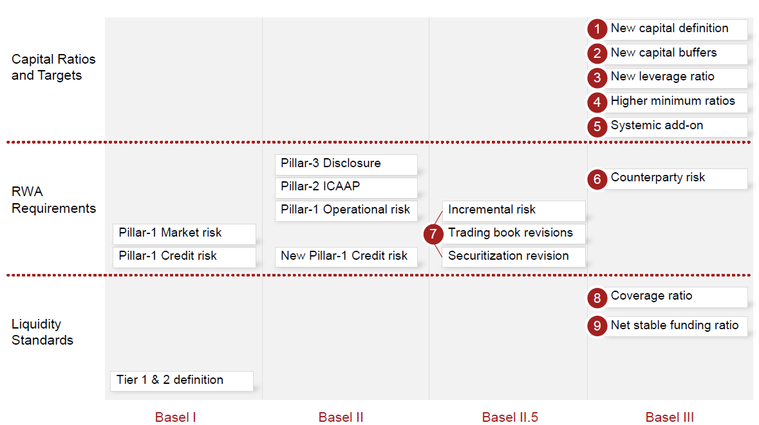
Comparison of Basel regimes
Source: PWC – Oct 10
Notes:
Source: The New Basel III Framework: Navigating Changes in Bank Capital Management - PWC – October 2010

Slide 55
Basel III – New Leverage Ratio
The new (proposed) leverage ratio is similar to that used in the US, with a minimum set at 3% (US: 5%)
the capital base (qualifying capital) will most likely be Tier 1 only
the gross asset value includes:
All assets held including cash and liquid assets
Repos
The value of
Lending commitments
Trade finance commitments
SBLCs and guarantees
Even if
Guarantee or collateral available
Netting available

Slide 56
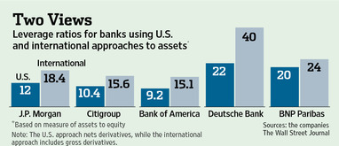
How to measure banks
Under U.S. accounting rules, banks offset many derivative holdings against others to come up with a net asset number. So while J.P. Morgan reports $1.7 trillion in gross derivative assets in notes to its financial statements, it includes just $85.5 billion on its balance sheet.
International rules require banks to show gross derivative values on their balance sheet with less netting allowed. That makes European banks appear larger than they would under U.S. rules.
Notes:
Source: WSJ “Deriving the True Size of U.S. Megabanks Is Far From Simple “ 23 Sept 12
http://online.wsj.com/article/SB10000872396390443890304578010573777776536.html?mod=dist_smartbrief

Slide 57
Basel III – New Liquidity Policy
On 17 December 2009 the BCBS published its paper titled ‘International framework for liquidity risk measurement, standards and monitoring’ for consultation. The paper proposes to set common minimum international standards for mitigating liquidity risk by using the following two ratios:
A liquidity coverage ratio (LCR) would require banks to hold a sufficient amount of high quality liquid assets to survive a severe stress for a period of 30 days. Outflows can only be met by generating liquidity from high quality government bonds and central bank deposits; and
A net stable funding ratio (NSFR) that measures stable funding relative to the liquidity of the assets funded, and the potential draw on off-balance sheet commitments over a one-year period
Source: FSA
Notes:
Source: http://www.fsa.gov.uk/pubs/plan/financial_risk_outlook_2010.pdf

Slide 58
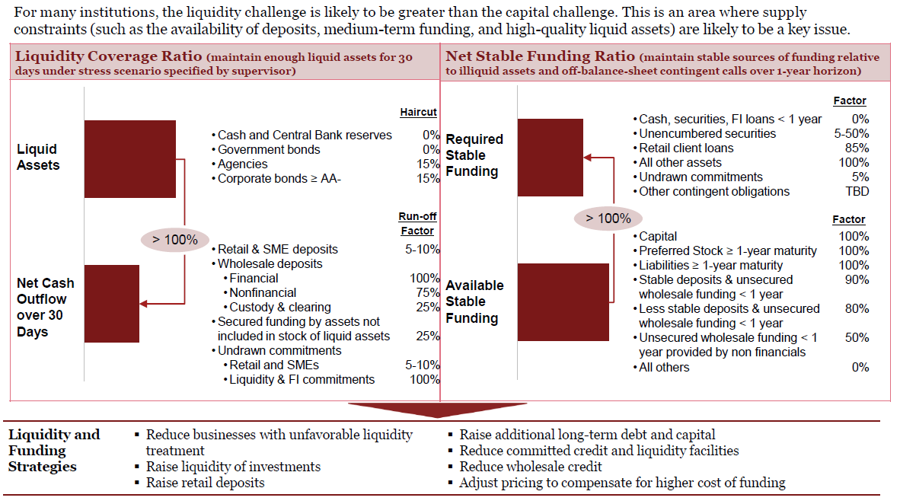
Basel III – new Liquidity and Funding Ratios
Source: PWC – 10/2010
Notes:
Source: The New Basel III Framework: Navigating Changes in Bank Capital Management - PWC – October 2010

Slide 59
Issues with Basel III
Basel guidelines are not directly enforceable
Each local regulator publishes implementation rules
Significant divergence of views between different regulators
Implementation timetable very long
Possibility of another crisis arising and delaying? (eg Basel II)
Ability of banks to raise substantial amounts of capital in crisis (e.g. European banks)
Local markets may prevent some of the rules from being directly implemented
e.g. Asian markets do not offer deep pools of liquid assets to use for liquidity coverage ratio
Significant impact of Basel rules on entire sectors such as trade finance, project finance, securitization
“Basel IV” and the “floor” to RWA
Implementation suspended due to pandemic

Slide 60
Central Banking in Asia: what are the most recent developments?
Group 20
Video link
https://www.youtube.com/watch?v=O7xePbiM0Og
Article link
https://assets.kpmg/content/dam/kpmg/xx/pdf/2018/12/basel-4-an-overview.pdf

Slide 61
Summary
1996 Market Risk Amendment
Basel II: 3-pillar structure; current issues
Basel III: leverage; liquidity; funding; issues
Comparison of Basel regimes

Slide 62

Test Your Understanding
Under Basel I what amount of capital do the banks have to maintain as a proportion of their risk weighted assets?
5%
3%
8%
12%
which type of risk was added in the coverage of capital requirement under Basel II?
Credit risk
Market risk
Operational risk
Systemic risk
Counterparty risk

Slide 63
Important other regulatory issues
Trump administration de-regulatory push and the regulatory pendulum
IFRS 9 implications – “fair value” accounting
IBOR transition
Balkanisation of regulation?

Slide 64
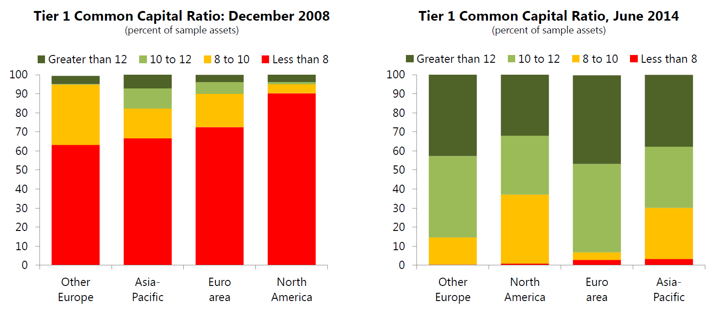
Impact of banking regulation: stronger global banks
Source: IMF Global Financial Stability Report 2014
Notes:
Source: IMF Global Financial Stability Report 2014

Slide 65
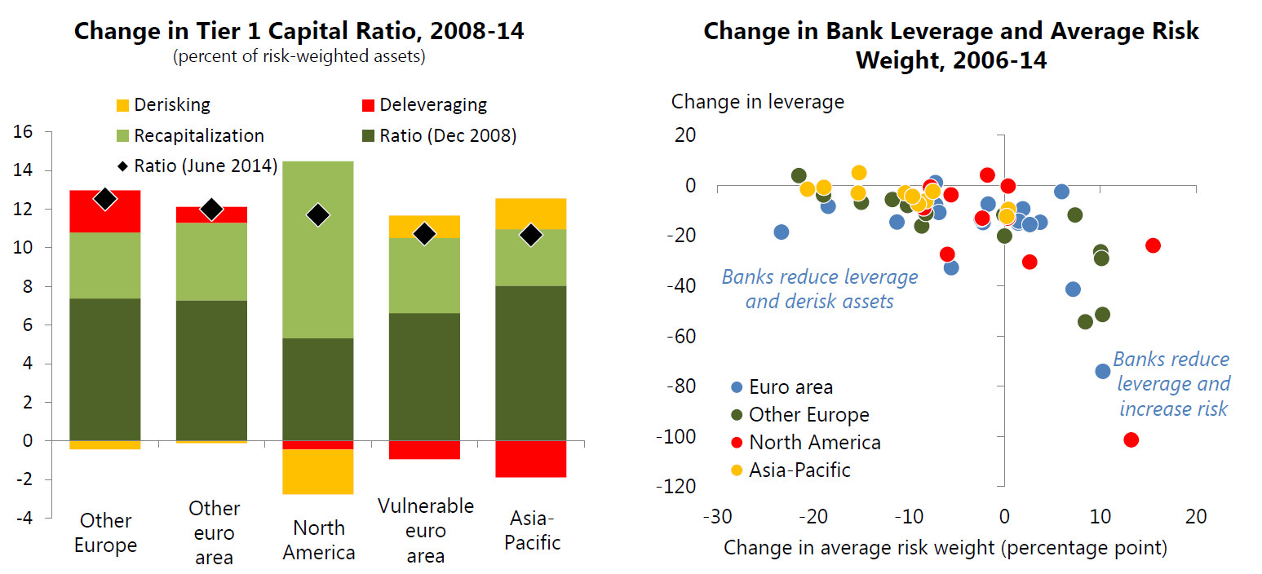
How banks got there
Source: IMF Global Financial Stability Report 2014

Slide 66
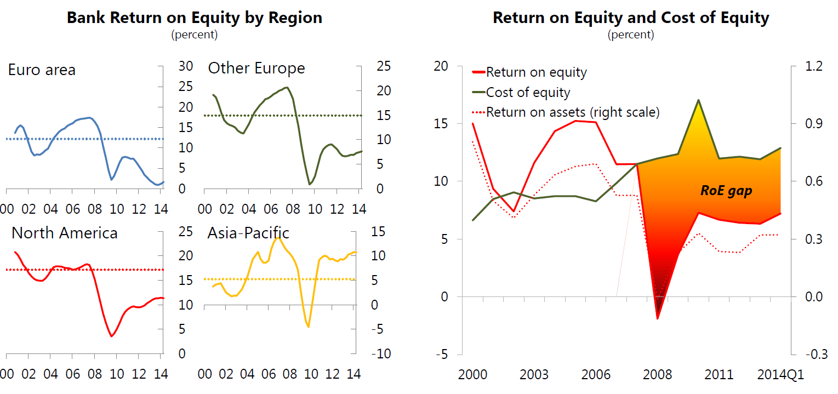
Result: Less profitable global banks
Source: IMF Global Financial Stability Report 2014

Slide 67
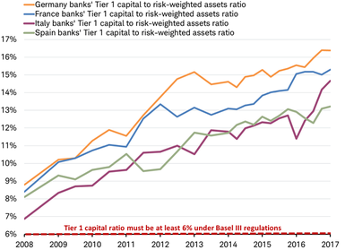
Domestic banks Tier 1 capital to risk-weighted assets
Source: Charles Schwab, Bloomberg data as of 8/15/2018
Notes:
Source: Charles Schwab “where will the next crisis come from” 20 August 2018 https://www.schwab.com/resource-center/insights/content/where-will-next-crisis-come-from#

Slide 68
Government Safety Net: deposit insurance and lender of last resort
PBOC implements Deposit Insurance Act on 1 May 15
Deposit insurance provides protection for the depositor and can increase confidence in the banking system
Can create moral hazard if implemented in an environment with weak institutions
Problem of “too big to fail” doctrine
Another form of government safety net is government support to depository institutions
Significant moral hazard
Common in many emerging markets
Current issue: bank ratings
Funding or liquidity support by the government can take 3 forms:
Provision of intraday or overnight liquidity to alleviate short term cash flow shortages
Lender of last resort support to banks experiencing funding difficulties on a short term basis
Provision of longer term liquidity and/or capital support
Notes:
PBOC implements China’s first national deposit insurance
One day after announcing its details, the People’s Bank of China will implement its Deposit Insurance Act, on May 1. All deposit-taking financial institutions in China, excluding branch offices of foreign banks in China, will be covered by the act. National deposit insurance will cover a maximum of Rmb500,000 per depositor per bank, including equivalent foreign currency deposits. The PBOC estimates the new system will provide full protection for 99.63% of depositors;
Prior to FDIC insurance, bank failures meant depositors lost money, and had to wait until the bank was liquidated to receive anything. This meant that “good” banks needed to separate themselves from “bad” banks, which was difficult for banks to accomplish.
The inability of depositors to assess the quality of a bank’s assets can lead to panics. If depositors fear that some banks may fail, their best policy is to withdraw all deposits, leading to a bank run, even for “good” banks. Bank panics did occur prior to the FDIC, with major panics in 1819, 1837, 1857, 1873, 1884, 1907, and 1930-1933.
By providing a safety net, depositors will not flee the banking system at the first sign of trouble. Indeed, between 1934 and 1981, fewer than 15 banks failed each year.
The FDIC handles failed banks in one of two ways: the payoff method, where the banks is permitted to fail, and the purchase and assumption method, where the bank is folded into another banking organization.
Implicit insurance is available in some countries where no explicit insurance organization exists.
The FDIC insurance creates moral hazard incentives for banks to take on greater risk than they otherwise would because of the lack of “market discipline” on the part of depositors.
The FDIC insurance creates adverse selection. Those who can take advantage of (abuse) the insurance are mostly likely to find banks attractive.
Regulators are reluctant to let the largest banks fail because of the potential impact on the entire system. This is known as the “Too Big to Fail” doctrine. This increases the moral hazard problem for big banks and reduces the incentive for large depositors to monitor the bank.
Consolidation has created many “large” banks, exasperating the too-big-to-fail problem. Further, banks now engage in more than just banking, which may inadvertently extend FDIC to such activities as underwriting.

Slide 69
Current issues in regulation
Regulatory tsunami and Balkanisation of regulation
Regulation of global financial institutions: whose responsibility? Home host? Subsidiarization?
Regulation of internet based financial services: security? Privacy? Whose responsibility?
New focus of regulators: market conduct and competition. Impact on market practices?
Cost of compliance and unintended consequences: problems of liquidity
Revolving door

Slide 70

The revolving door issue: independence of regulators?
In the US and elsewhere, many regulators are headed by former financial industry top staff
Top regulators leave for a career in institutions they use to regulate…
..Or in law firms representing them
“Government Sachs” is but one example (alumni include “Super Mario at ECB and the Super Mario at Bank of Italy)

Slide 71
Course Map
Overview
Regulations
Goals of Financial Regulation
Banking Regulation
Financial Regulation in Hong Kong
Banking Regulation
Monetary Policy
Spring 10

Slide 72
HK Financial Services Regulation
Financial Secretary
MPFA
HKMA
IA
SFC
Pension Funds
Banks
Insurance
Securities Firms
Fund Managers
Notes:
The Financial Secretary, assisted by the Secretary for Financial Services and the Treasury, has responsibility for policies for maintaining the stability and integrity of Hong Kong’s financial system and the status of Hong Kong as an international financial centre.
In support of these policies, the Monetary Authority is responsible, among other things, for:
Promoting the general stability and effective working of the banking system
Promoting the development of the debt market, in co-operation with other relevant bodies
Matters relating to the issuance and circulation of legal tender notes and coins
Promoting the safety and efficiency of the financial infrastructure through the development of payment, clearing and settlement systems and, where appropriate, the operation of these systems
Seeking to promote, in co-operation with other relevant bodies, confidence in Hong Kong’s monetary and financial systems, and appropriate market development initiatives to help strengthen the international competitiveness of Hong Kong’s financial services.
The Securities and Futures Commission (SFC) is an independent statutory body established by the Securities and Futures Commission Ordinance (SFCO). The SFCO and nine other securities and futures related ordinances were consolidated into the Securities and Futures Ordinance (SFO), which came into operation on 1 April 2003.
SFC is responsible for administering the laws governing the securities and futures markets in Hong Kong and facilitating and encouraging the development of these markets.
SFC’s statutory regulatory objectives as set out in the SFO are:
To maintain and promote the fairness, efficiency, competitiveness, transparency and orderliness of the securities and futures industry;
To promote understanding by the public of the operation and functioning of the securities and futures industry;
To provide protection for members of the public investing in or holding financial products;
To minimise crime and misconduct in the securities and futures industry;
To reduce systemic risks in the securities and futures industry; and
To assist the Financial Secretary in maintaining the financial stability of Hong Kong by taking appropriate steps in relation to the securities and futures industry.
The SFC is divided into four operational divisions: Corporate Finance, Intermediaries and Investment Products, Enforcement, and Supervision of Markets. The Commission is supported by the Legal Services Division and Corporate Affairs Division The relevant legal framework for the regulation of insurers is provided by the Insurance Companies Ordinance (Cap.41), and its subsidiary legislation including Insurance Companies (Determination of Long Term Liabilities) Regulation, Insurance Companies (Margin of Solvency) Regulation and Insurance Companies (General Business) (Valuation) Regulation. The same Ordinance also provides a legal backing for the self-regulatory system of insurance intermediaries. The Commissioner of Insurance, in his role as the Insurance Authority, is responsible for the regulation of the insurance industry.
The principal function of the IA is to regulate the insurance industry for the protection of existing or potential policy holders and the promotion of the general stability of the insurance industry. He is however not involved with the daily operations of an insurer, including determination of the terms and conditions of insurance policies or the fixing of premium rates. The IA works closely with the insurance industry to encourage the provision of better services to the insuring public and greater transparency in an insurer's operations. For example, the IA has been working closely with the insurance industry to implement the Insurance Intermediaries Quality Assurance Scheme with a view to enhancing the professional standard of insurance intermediaries. Under the Scheme, insurance intermediaries, their responsible officers/chief executives and technical representatives are required to pass the Insurance Intermediaries Qualifying Examination conducted by the Vocational Training Council, unless otherwise exempted, before they can be registered or authorized as such. Thereafter, they are required to attend continuing professional development programmes.
As at 31 December 2006, 181 insurers (approximately 64% general business insurers, 26% long term business (or life) insurers and 10% composite insurers) were authorized in Hong Kong. Of these insurers, 91 were companies incorporated in Hong Kong while the rest come from 22 different countries/regions, with the US (17) taking the lead, to be followed by Bermuda (15) and the UK (12).
In August 1995, Hong Kong took a major step in enacting the Mandatory Provident Fund Schemes Ordinance to provide a formal system of retirement protection. The ordinance provides the framework for the establishment of a system of privately managed, employment-related MPF schemes to accrue financial benefits for members of the workforce when they retire.
The Mandatory Provident Fund Schemes Authority (MPFA) was established in September 1998 to regulate, supervise and monitor the operation of the MPF System. The MPF System came into operation on December 1, 2000.

Slide 73







Who is who in HK financial services regulation?
3
2
1
4
5
6
7
Notes:
Paul Chan, Financial Secretary Source (Jan 17): http://www.fso.gov.hk/eng/index.htm
Christopher Hui, Secretary for Financial Services and the Treasury (April 020) http://www.gov.hk/en/about/govdirectory/po/sfst.htm
Eddie Yue Chief Executive HKMA from 2020 https://www.hkma.gov.hk/eng/about-us/the-hkma/the-chief-executives-committee/
Clement Cheung, CEO, Insurance Authority https://www.ia.org.hk/en/aboutus/welcome/CEO_message.html
Ashley Alder, CEO of the SFC http://www.sfc.hk/sfc/html/EN/aboutsfc/structure/commission (2011 to present, appointment expires Sept 23)
David Wong, Chairman MPFA http://www.mpfa.org.hk/engmpfa/organizational_structure/board_supporting_committees/management_board/index.jsp
Nicolas Aguzin, Chief Executive, HKEx appointment starts 24 may 21 (replaced Charles Li) https://www.hkex.com.hk/News/News-Release/2021/210209news?sc_lang=en

Slide 74
Role of the HKMA
Established 1993 by merger of the Office of the exchange Fund and the Office of the Commissioner of Banking the Hong Kong Monetary Authority (HKMA) is Hong Kong’s central banking institution
Functions & objectives:
Maintain currency stability
Promote safety and stability of the banking system
Enhance the efficiency, integrity & development of the financial system
Managing Hong Kong’s official reserves
Unlike other central banks, HKMA does not:
Issue banknotes
Act as banker to the Government: this function is historically carried out by commercial banks
Notes:
Established in April 1993, the Hong Kong Monetary Authority (HKMA) is the government authority in Hong Kong responsible for maintaining monetary and banking stability.
The HKMA’s policy objectives are
To maintain currency stability, within the framework of the Linked Exchange Rate system, through sound management of the Exchange Fund, monetary policy operations and other means deemed necessary
To promote the safety and stability of the banking system through the regulation of banking business and the business of taking deposits, and the supervision of authorized institutions
To enhance the efficiency, integrity and development of the financial system, particularly payment and settlement arrangements.
The Hong Kong Monetary Authority is Hong Kong’s central banking institution. The HKMA has four main functions: maintaining the stability of the Hong Kong dollar; promoting the safety of Hong Kong’s banking system; managing Hong Kong’s official reserves; and maintaining and developing Hong Kong’s financial infrastructure.
The HKMA is accountable to the people of Hong Kong through the Financial Secretary, who appoints the Monetary Authority, and through the laws passed by the Legislative Council that set out the Monetary Authority’s powers and responsibilities.

Slide 75
Monetary Policy in Hong Kong
The Financial Secretary is responsible for determining the monetary policy objective and the structure of the monetary system of Hong Kong
The Monetary Authority is on his own responsible for achieving the monetary policy objective, including determining the strategy, instruments and operational means for doing so. He is also responsible for maintaining the stability and integrity of the monetary system of Hong Kong.
The monetary policy objective of Hong Kong is currency stability. This is defined as a stable external exchange value of the Hong Kong dollar in terms of its exchange rate against the US dollar at around HK$7.80 to one US dollar. The monetary policy objective is achieved through the Linked Exchange Rate system, which has been implemented since 17 October 1983.
Notes:
The Financial Secretary is responsible for determining the monetary policy objective and the structure of the monetary system of Hong Kong: a letter from the Financial Secretary to the Monetary Authority dated 25 June 2003 specifies that these should be currency stability defined as a stable exchange value at around HK$7.80 to one US dollar maintained by Currency Board arrangements. The Monetary Authority is on his own responsible for achieving the monetary policy objective, including determining the strategy, instruments and operational means for doing so. He is also responsible for maintaining the stability and integrity of the monetary system of Hong Kong.
The Linked Exchange Rate System
The monetary policy objective of Hong Kong is currency stability. This is defined as a stable external exchange value of the Hong Kong dollar in terms of its exchange rate against the US dollar at around HK$7.80 to one US dollar. The monetary policy objective is achieved through the Linked Exchange Rate system, which has been implemented since 17 October 1983. The Linked Exchange Rate system plays an important part in supporting Hong Kong’s role as a trading, service and financial centre.

Slide 76
HKMA initiatives : SVFs
STORED VALUE FACILITIES (SVFs)
SVF usage continued to grow in Q4 2019:
Accounts in use: 63.1 million (+12.5% year-on-year (yoy))
Average daily transaction value: HK$576 million (+10.1% yoy)
SVF licensees continue to extend their business reach, e.g. cross-border retail payments, public transport and small merchants
Continue to oversee six designated RPSs
Source: HKMA LegCo presentation April 2020
Notes:
https://www.hkma.gov.hk/media/eng/doc/about-the-hkma/legislative-council-issues/20200504e1.pdf

Slide 77
HKMA initiatives: Virtual Banks in Hong Kong
Introduction of Virtual Banking
Eight licenses awarded by April 2020
Relatively onerous requirements (min HKD 300M capital requirement and at least one physical presence)
AIRSTAR BANK LIMITED
ANT BANK (HONG KONG) LIMITED
FUSION BANK LIMITED
LIVI VB LIMITED
MOX BANK LIMITED
PING AN ONECONNECT BANK (HONG KONG) LIMITED
WELAB BANK LIMITED
ZA BANK LIMITED
Notes:
Source: HKMA https://www.hkma.gov.hk/eng/key-functions/banking/banking-regulatory-and-supervisory-regime/virtual-banks/

Slide 79
Latest FinTech Initiatives
Notes:
Fintech Career Accelerator Scheme – Gap year placement programme • FCAS is a talent development scheme initiated by the HKMA since 2016 to nurture fintech talents in Hong Kong. Its gap year placement programme offers full-time, semester-based internship positions for university students to work on fintech projects at banks or stored value facility operators. • In the current intake of 2020/21, the HKMA, 22 banks (including four virtual banks) and one stored value facility operator offered around 150 internship positions, attracting over 1,000 applications.
Connection of PBoC Trade Finance Platform and eTradeConnect • eTradeConnect was developed by a consortium of 12 banks in Hong Kong. • In November 2019, a Memorandum of Understanding was signed between the operators of eTradeConnect and People’s Bank of China Trade Finance Platform to conduct a Proof-of-Concept trial on connecting the two platforms. • The HKMA will continue to facilitate the development of eTradeConnect and its connection with platforms in other regions.
Cybersecurity Fortification Initiative • The CFI was first launched in 2016. Due to changes in the global cybersecurity landscape, the HKMA considers that there is a need to enhance the existing CFI framework. • In January 2020, the HKMA began a consultation to seek the industry’s feedback on the proposed enhancements

Slide 80
HKMA measures to respond to pandemic
Notes:
Source: HKMA Report to Legco 4 May 2020 https://www.hkma.gov.hk/eng/data-publications-and-research/legislative-council-issues/

Slide 81
Fighting the Virus and Supporting the Economy
Notes:
Source: HKMA Report to Legco 4 May 2020 https://www.hkma.gov.hk/eng/data-publications-and-research/legislative-council-issues/

Slide 82
Summary
HK Financial Services Regulation Framework
Role and objectives of HKMA
Monetary policy in HK

Slide 83
Test Your Understanding
In HK, which is the banking regulator?
SFC
MPFA
HKMA
ICAC
Which is the primary objective of the HKMA?
Make HK great again
Protect the peg
Keep banks safe

Slide 84
China’s Financial Regulators (pre-reform)
State Council
Special institutions directly under the State Council (1)
Organizations directly under the State Council (19)
Ministries and Commissions under the State Council (28)
Institutions directly under the State Council (14)
China Banking Regulatory Commission (CBRC)
China Securities Regulatory Commission (CSRC)
China Insurance Regulatory Commission (CIRC)
National Council for Social Security Fund
Ministry of Foreign Affairs
National Development and Reform Commission
Ministry of Finance
Ministry of Labor and Social Security
Ministry of Commerce
People’s Bank of China
General Administration of Customs
State Administration of Taxation
State Administration for Industry and Commerce
SAFE
State-owned Assets Supervision and Administration Commission
Working Orangs of the State Council (4)
Overseas Chinese Affairs Office of the State Council
Hong Kong and Macao Office of the State Council
Legislative Affairs Office of the State Council
Research Office of the State Council
New system introduced to coordinate financial regulation
Notes:
Source: http://www.ibtimes.co.uk/articles/500178/20130820/china-financial-sector-coordination-group-pboc.htm
China's government will create a new agency, led by the central bank, in a bid to coordinate financial supervision and bolster regulation in the financial sector.
According to a statement by China's State Council, dated 15 August, the new body will coordinate monetary and financial supervisory policies as well as supervise legislation without changing the roles of the country's incumbent watchdogs.
The body will consist of the heads of the banking, securities, insurance and foreign-exchange regulatory bodies, according to the statement.
The members are the People's Bank of China (PBoC), the China Banking Regulatory Commission (CBRC), the China Securities Regulatory Commission (CSRC), the China Insurance Regulatory Commission (CIRC) and the State Administration of Foreign Exchange (SAFE).
Zhou Xiaochuan, the governor of the PBoC will act as the head of the group, while the CBRC, CSRC, CIRC and SAFE will be represented by Shang Fulin, Xiao Gang, Xiang Junbo and Yi Gang, respectively.
The group will meet on a regular basis but won't replace the authority of the cabinet or the existing industry watchdogs, the statement added. It will report to the cabinet and will not function as a policy maker.
If needed, the new agency can also invite the National Development and Reform Commission (NDRC), China's most powerful economic planner, and the Ministry of Finance to its meetings.

Slide 85
China’s Financial Regulators (post-reform)
Financial Stability Development Committee (FSDC), a cabinet-level “super regulator”, is meant to oversee and coordinate China’s four existing financial regulators.
FSDC
The People’s Bank of China (PBOC) assumes responsibility for drafting key regulations and prudential oversight in banking and insurance to address systemic risk
PBOC
The insurance regulator, the China Insurance Regulatory Commission (CIRC), and the banking regulator, the China Banking Regulatory Commission (CBRC), merge into the China Banking Insurance Regulatory Commission (CBIRC).
CSRC
CBIRC
Notes:
On 13 March 2018, the National People’s Congress announced a plan to continue the overhaul of China’s financial regulatory system. The key changes are as follows:
• The insurance regulator, the China Insurance Regulatory Commission (CIRC), and the banking regulator, the China Banking Regulatory Commission (CBRC), will merge into the China Banking Insurance Regulatory Commission (CBIRC). This merger is meant to resolve problems relating to cross-regulation and an unclear delineation of responsibilities; and
• The newly created CBIRC will cede some authority to China’s central bank, the People’s Bank of China (PBOC), which will assume responsibility for drafting key regulations and prudential oversight in banking and insurance.
These reforms are meant to address the high systemic risk which has plagued China’s financial system in recent years and which many observers have linked to the fragmentary nature of its regulatory system.
The State Council took the first major step in addressing this problem in July of 2017, when it announced the establishment of the Financial Stability Development Committee (FSDC), a cabinet-level “super regulator” meant to oversee and coordinate China’s four existing financial regulators.
Though the precise workings of this new regulatory system are yet to be revealed, we now know its basic structure. The Pre- and Post-Reform structures are summarized in Figures 1 and 2 below:
The placing of each of the four regulators on a level horizontal plane is deliberate, as they tend to function independently, though the PBOC does have greater powers in terms of drafting financial reforms and ensuring financial stability. People’s Bank of China (PBOC) China Securities Regulatory Commission (CSRC) China Insurance Regulatory Commission (CIRC) China Banking Regulatory Commission (CBRC) Post-Reform Looking forward, we expect that China’s new regulatory framework will implement stricter regulations that will put the nation’s financial system on a sounder footing. This will be a continuation of an ongoing trend towards increased regulation and stricter oversight. As discussed in our 2017 China Insurance Review, this trend has been particularly pronounced in China’s insurance sector.
Ultimately, this should be propitious to foreign investors, which, relative to their Chinese counterparts are more experienced in dealing with a heavy compliance burden. As well, one of the stated goals of the FSDC is to coordinate efforts to further open China’s financial sector to foreign investment.

Slide 86
Summary
Key regulators in China

Slide 87
Course Map
Overview
Regulations
Banking Regulation
1. The Federal Reserve System
2. Foreign Central Banks
3. Monetary Policy
Monetary Policy
Spring 10

Slide 88
Banking Regulation and Monetary Policy (in normal times – pre-pandemic)
Central Bank’s tools of monetary policy:
Tools of banking regulation:
Open market operations (central banks purchase/sale of financial assets, generally government securities)
Discount rate/loans (banks borrowing from central bank)
Reserve requirements
Restrictions on asset holdings
Capital requirement
Liquidity requirement
Disclosure requirements
Bank supervision
Deposit insurance
Consumer protection
Restriction on competition
Notes:
1. Restrictions on Asset Holdings (e.g. portfolio diversification obligations)
Reduces moral hazard of too much risk taking
2. Capital Requirement
Leverage ratio
Capital adequacy ratio
Capital requirement on trading activities
3. Liquidity requirement
Generally expressed as minimum liquidity ratio/reserve requirement
May include other ratios such as transformation ratio
4. Disclosure Requirements
Better info reduces asymmetric info problem
5. Bank Supervision: Chartering and Examination (licensing of banks by central authority)
A. Reduces adverse selection problem of risk takers or crooks owning banks
B. Reduces moral hazard by preventing risky activities
C. New trend: assessment of risk management
6. Government Safety Net and Deposit Insurance
A. Prevents bank runs due to asymmetric info: depositors can't tell good from bad banks
B. Creates moral hazard incentives for banks to take on too much risk
C. Creates adverse selection problem of crooks and risk-takers wanting to control banks
D. Too-Big-to-Fail increase moral hazard incentives for big banks and is unfair
7. Consumer Protection
A. Standardized interest rates (APR)
B. Prevent discrimination: e.g., CRA
8. Restrictions on Competition to Reduce Risk-Taking
A. Branching restrictions
B. Separation of banking and securities industries: Glass-Steagall

Slide 89
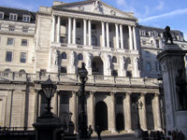
Central Banking
Central bank = Government entities in charge of monetary policy
Central bank actions affect
Interest rates
Amount of credit
Money supply
These actions impact
Financial markets
Aggregate output
Inflation
The Bank of England is one of the oldest central banks. It was founded in 1694 and nationalized in 1946.
Source: Wikipedia

Slide 90
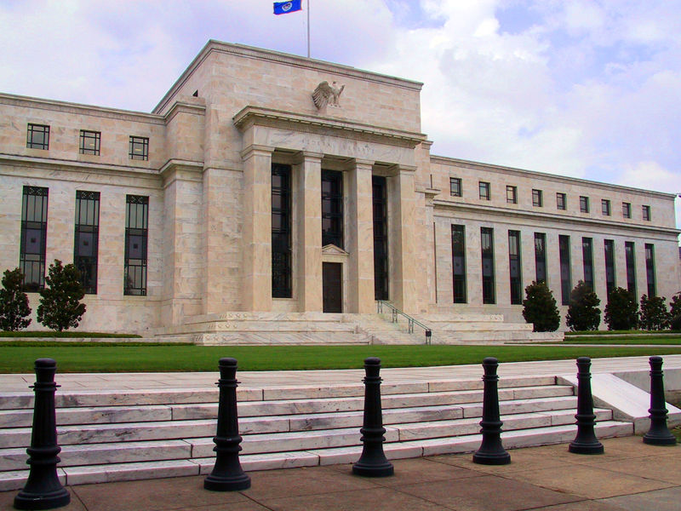
Purpose of the Fed
The Federal Reserve System (the “Fed”) is the central bank of the US
It was set up in 1913 by Congress (Federal Reserve Act 1913)
The Fed structure was a result of a compromise (fear of central government v. need for stability in the system) and was designed to give the Fed a broad perspective on the economy
The Federal Reserve headquarters in Washington, DC
Photograph taken by Dan Smith. Source: Wikipedia
Notes:
Historically Americans are hostile to banks and particularly central banks because they fear concentration of power in Washington and worry about representation of local regional views  Resisted installation of central bank. Fear of centralized power guided central bank activities in the 19th century.
The First Bank of the U.S. was disbanded in 1811. The Second Bank of the U.S. was disbanded in 1836 when President Andrew Jackson vetoed its renewal. As a result, banking panics became regular events, culminating in the panic of 1907. Widespread bank failures and depositor losses convinced the U.S. that a central bank was needed. Fear of a “central authority” was rampant - people worried that powerful Wall Street interests would manipulate the system. Questions arose as to whether such a monetary authority would be private or a government institution. Federal Reserve Act of 1913 was a compromise that created the Federal Reserve System including checks and balances.

Slide 91
Responsibilities of the Fed
Today, the Federal Reserve's responsibilities fall into four general areas.
Conducting the nation's monetary policy by influencing money and credit conditions in the economy in pursuit of full employment and stable prices.
Supervising and regulating banks and other important financial institutions to ensure the safety and soundness of the nation's banking and financial system and to protect the credit rights of consumers.
Maintaining the stability of the financial system and containing systemic risk that may arise in financial markets.
Providing certain financial services to the U.S. government, U.S. financial institutions, and foreign official institutions, and playing a major role in operating and overseeing the nation's payments systems.
Notes:
Source: Fed https://www.federalreserve.gov/faqs.htm

Slide 92
Formal Structure of the Federal Reserve System
Design was intended to diffuse power along the following dimensions:
Regions of the U.S.
Government and private sector interests
Needs of bankers, businesses, and the public
The system as it exists now includes:
12 Federal Reserve Banks
Member Banks (~ 3,600)
Board of Governors (BOG) of the Federal Reserve System
Federal Open Market Committee (FOMC)
Federal Advisory Council (FAC)
Source: Mishkin/Eakins

Slide 93
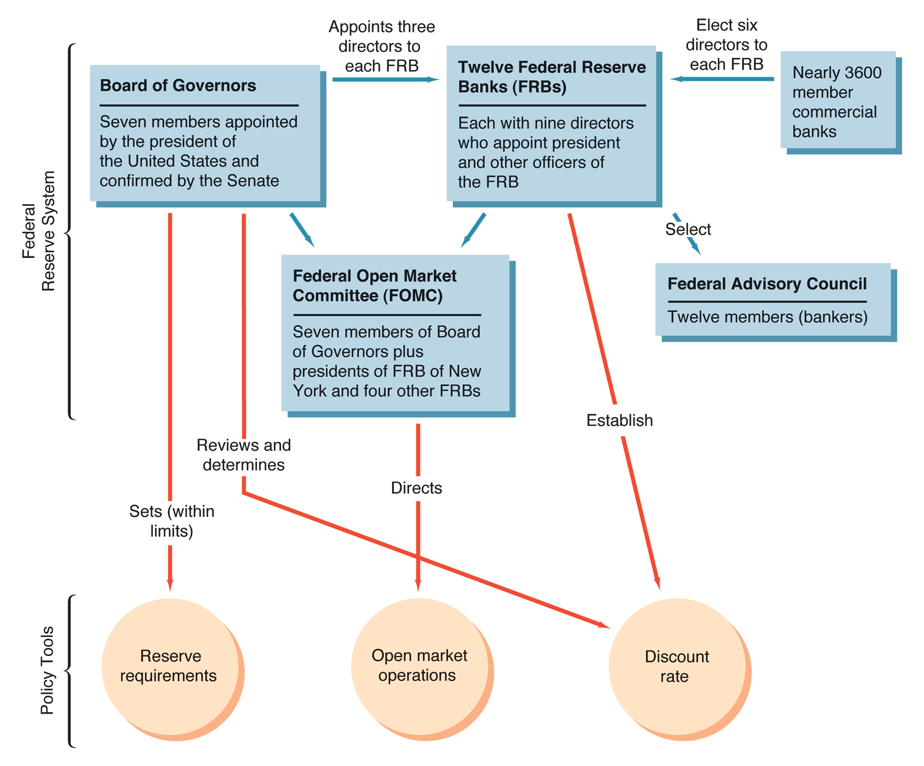
Formal Structure of the Federal Reserve System
Source: Mishkin/Eakins

Slide 94
Twelve Federal Reserve Banks
Each district has a main Federal Reserve Bank and at least one branch office
The banks are “quasi-public”; they are not government agencies nor private banks
Owned by member commercial banks in the district, who collect a 6% dividend
Fed Bank presidents are not subject to congressional confirmation (designed to promote independence from politicians)
Member banks elect six directors, while three directors are appointed by the Board of Governors
Source: Mishkin/Eakins
Notes:
The Fed of NY is the most important as it has special functions. In addition it is the regulator of some of the largest banks in the world thus it has a special role.

Slide 95
Twelve Federal Reserve Banks (Cont)
Directors represent professional bankers, prominent business leaders, and public interests (three from each group)
Class A directors are elected by member banks and represent them
Class B directors are elected by member banks but represent the public; they cannot be officers or directors of banks
Class C directors represent the public but are picked by the Fed (Board of Governors) ; they cannot be officers or directors of banks AND cannot own shares of banks or bank holding companies
Current issue: conflicts of interest at the Fed: composition of the board of the NY Fed raises issues of corporate governance - Jamie Dimon urged to resign from the board (June 2012)
Source: Mishkin/Eakins
Notes:
The Fed of NY is the most important as it has special functions. In addition it is the regulator of some of the largest banks in the world thus it has a special role.
http://www.bloomberg.com/news/print/2012-06-13/regional-feds-need-directors-not-tied-to-banks.html The Regional Feds Need More Independence By Jonathan Reiss - Jun 13, 2012 Bloomberg
All the fuss about whether Jamie Dimon, the chief executive officer of JPMorgan Chase & Co., should remain on the New York Federal Reserve Bank board is missing a larger issue. The entire board is connected to the banking industry and needs reform.
It is imperative that the board include some directors who are independent of the banking industry because it performs many vital public functions, including selecting the president of the New York Fed, who also serves as vice chairman of the policy- making Federal Open Market Committee. Yet none of the current directors is entirely independent, not even the six who by law should represent the public.
Here’s how the board is supposed to be structured: The nine directors are divided into three classes, each containing three people. Class A directors are bankers, elected by the member banks. Dimon is one of these. Classes B and C are designated to represent the public and are specifically not allowed to be bankers. Nevertheless, Class B directors are also elected by the member banks. And this raises the question, whose interests are they likely to represent -- the public or the banks? Their independence would be enhanced if they were chosen in a different manner. Class C directors are appointed by the Fed governors, who could be careful to select independent people. Yet the three Class C directors now at the New York Fed are presidents of Columbia University, the Metropolitan Museum of Art and the Partnership for New York City. All three head nonprofit organizations that rely on contributions from financial corporations or their executives. They all report to boards partially occupied by financiers such as Jamie Dimon; Lloyd Blankfein, the CEO of Goldman Sachs Group Inc.; and Vikram Pandit, the CEO of Citigroup Inc.
To preserve their independence, the directors are not allowed to own a single share of bank stock, but apparently it is fine for them to accept millions in contributions from bankers on behalf of the institutions they run.
An Institutional Flaw at the Heart of the Federal Reserve By SIMON JOHNSON June 14, 2012, 11:37 am NY Times http://economix.blogs.nytimes.com/2012/06/14/an-institutional-flaw-at-the-heart-of-the-federal-reserve/
the Federal Reserve Act should be amended. The boards of regional Federal Reserve banks should become advisory groups. If local boards are retained in any fashion, they should be filled with distinguished experts toward the end of their careers – as is the case at the National Transportation Safety Board.
Columbia University should return the donations it received from JPMorgan and the JPMorgan Chase Foundation while Mr. Bollinger was a Class C director. And Mr. Dimon should resign from the board of the New York Fed.

Slide 96
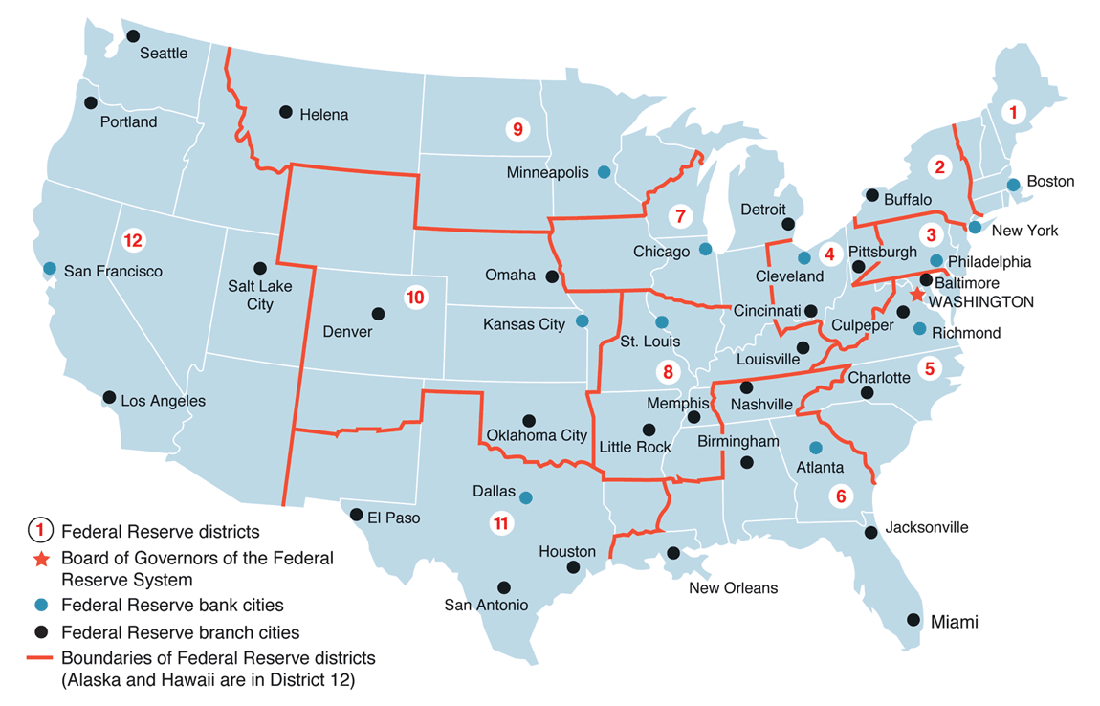
Federal Reserve Banks
The Fed Banks of NY, Chicago and San Francisco are the largest; together they hold > 50% of the assets of the Fed
Source: Mishkin
Notes:
Each Federal Reserve district has a Federal Reserve Bank and the Bank may have different branches. The Fed of NY is the most important as it holds ~ ¼ of the assets of the Fed plus has several important functions (open market ops trading desk).

Slide 97

The Federal Reserve Bank of New York
Largest bank supervision group in the Fed system: Fed district of NY is home to some of the largest banks in the world
Houses the open market trading desk and the FX desk → key role in bond and FX markets
Only Fed bank to be a member of the BIS → NY Fed president together with Chairman of BOG represents the Fed at regular meetings with other central banks
Repository of large gold reserves (bigger than Fort Knox)
President of NY Fed is the only permanent member of the FOMC
The Federal Reserve Bank of New York, at 33 Liberty Street in Manhattan.
Source: Wikipedia
https://www.youtube.com/watch?v=-38idGW6bW8
Fun Trivia: The Bruce Willis 1995 movie “Die Hard with a Vengeance” features the Fed of NY and its gold reserves

Slide 98
Federal Reserve Bank Functions
General
Monetary Policy
Act as fiscal agent for the Federal Government
Clear checks, process electronic payments and issue, redeem and transfer US TSY securities
Issue currency
Check processing for depository institutions
Electronic payments (ACH)
Evaluate bank mergers and expansions
Lender to member banks
Liaison between local community and the Federal Reserve System
Perform bank examinations
Establish the “discount rate” at which member banks may borrow from the Federal Reserve Bank (subject to BOG review)
Determine which banks receive loans
Elect one member to the Federal Advisory Council
Five of the 12 bank presidents vote in the Federal Open Market Committee
Electronic payments surpass paper payments in volume: in 2003 6.8 Bn ACH transactions representing $16.8 Tr compared to 16 trillion checks representing $15.8 Tr
Source: Mishkin/Eakins
Notes:
The Federal Reserve Banks act as fiscal agents for the federal government:
Pay treasury checks
Process electronic payments
Issue, transfer and redeem US treasury securities
The Federal Reserve Banks provide services to other central banks and international agencies, including maintaining noninterest bearing accounts in US$, securities safekeeping accounts and accounts for safekeeping gold.
The Fed Banks clear checks for the banking system: in 2003 the reserve banks cleared 58% of interbank checks; the remainder is cleared by depository institutions among themselves.
The Fed developed the Automated Clearing House (ACH) together with the private sectors in the 70s as an alternative to paper payments.
The ACH is a nationwide system for processing credit and debit transfers electronically; payments are sent by banks and processed by the Fed Banks in batches. Currently the largest volume in payments is through ACH, although checks still represent a large portion of the number of transactions.

Slide 99
Member Banks
All national banks (banks chartered by the Office of the Comptroller of the Currency) are required to be members
State commercials banks may elect to join but are not required to
Prior to 1980, only member banks were required to maintain reserves as deposits with the Federal Reserve Banks. Non-member banks were subject to reserve requirements determined by their states
Depository Institutions Deregulation and Monetary Control Act 1980 → by 1987, all depository institutions became subject to the same reserve requirements to keep deposits at the Fed and all depository institutions were given access to the Federal reserve facilities such as the discount window and Fed check clearing
Currently few distinctions between member and non-member banks
Currently about 1/3 of the commercial banks in the US are members of the Fed
Source: Mishkin/Eakins

Slide 100
Board of Governors
The BOG is headquartered in Washington, DC
The seven governors are appointed by the President, and confirmed by the Senate, for 14-year non-renewable terms on a rotating schedule
All are members of the FOMC
Effectively set the discount rate
(since 2008) Sets the interest rate the Federal Reserve pays on reserve balances to help implement the FOMC's monetary policy decisions.
Serve in an advisory capacity to the President of the United States, and represent the U.S. in foreign economic matters
Other duties as established by legislation (e.g., Regulation Q)
Source: Mishkin/Eakins
Notes:
The seven members of the Board of Governors of the Federal Reserve System are nominated by the President and confirmed by the Senate. A full term is fourteen years. One term begins every two years, on February 1 of even-numbered years. A member who serves a full term may not be reappointed. A member who completes an unexpired portion of a term may be reappointed. All terms end on their statutory date regardless of the date on which the member is sworn into office. The Chairman and the Vice Chairman of the Board are named by the President from among the members and are confirmed by the Senate. They serve a term of four years. A member's term on the Board is not affected by his or her status as Chairman or Vice Chairman.
Once appointed, Governors may not be removed from office for their policy opinions.
The chairman and vice-chairman are chosen by the President from among the sitting Governors for four-year terms; these appointments are also subject to Senate confirmation. By law, the chairman reports twice a year to Congress on the Federal Reserve's monetary policy objectives. He or she also testifies before Congress on numerous other issues and meets periodically with the Treasury Secretary.
Under the provisions of the original Federal Reserve Act, the Federal Reserve Board was composed of seven members, including five appointive members, the Secretary of the Treasury, who was ex-officio chairman of the Board, and the Comptroller of the Currency. The original term of office was ten years, and the five original appointive members had terms of two, four, six, eight, and ten years respectively. In 1922 the number of appointive members was increased to six, and in 1933 the term of office was increased to twelve years.
The Banking Act of 1935, approved Aug. 23, 1935, changed the name of the Federal Reserve Board to the Board of Governors of the Federal Reserve System and provided that the Board should be composed of seven appointive members; that the Secretary of the Treasury and the Comptroller of the Currency should continue to serve as members until Feb. 1, 1936; that the appointive members in office on the date of that act should continue to serve until Feb. 1, 1936, or until their successors were appointed and had qualified; and that thereafter the terms of members should be fourteen years and that the designation of Chairman and Vice Chairman of the Board should be for a term of four years.
Date after words "Resigned" and "Retired" denotes final day of service.
Chairman and Vice Chairman were designated Governor and Vice Governor before Aug. 23, 1935.Governors are required to come from different Federal reserve districts to prevent the interests of one region from being overrepresented.

Slide 101






Current members of the BOG
Chair: Jerome H. Powell took office as Chairman of the Board of Governors of the Federal Reserve System on February 5, 2018, for a four-year term by President Trump.
Mr. Powell has served as a member of the Board of Governors since taking office on May 25, 2012, to fill an unexpired term. He was reappointed to the Board and sworn in on June 16, 2014, for a term ending January 31, 2028.
Vice Chairman: Richard Clarida (appointed by Trump began a four-year term on Sept 17, 2018, and took office as Board member to fill an unexpired term ending Jan 31, 2022)
Vice Chair for Supervision: Randall K. Quarles (appointed by Trump in 2017, to fill an unexpired term ending Jan 31, 2018; He was reappointed to the Board and sworn in on Jul 23, 2018, for a term ending Jan 31, 2032. His appointment as Vice Chair expires 13 Oct 2021)
Governor: Dr. Lael Brainard (appointed by Obama in 2014, to fill an unexpired term ending January 31, 2026)
Governor: Michelle Bowman (appointed by Trump on November 26, 2018, to fill an unexpired term ending Jan 31, 2020. She was reappointed to the Board on Jan 23, 2020, and sworn in on Jan 30, 2020, for a term ending Jan 31, 2034.)
Governor: Christopher Waller (appointed by Trump on Dec 18, 2020, to fill an unexpired term ending Jan 31, 2030.
Notes:
Source: Fed http://www.federalreserve.gov/aboutthefed/bios/board/boardmembership.htm
The Federal Reserve Board consisted of seven members, including the Secretary of the Treasury and the Comptroller of the Currency, who were members ex officio, meaning that they were members by virtue of their office. The President of the United States appointed the other five members, by and with the advice and consent of the Senate. Of the five appointed members, one was designated by the president as governor and one as vice governor. The governor of the Federal Reserve Board, subject to its supervision, was the active executive officer. The Banking Act of 1933 increased the number of appointed members from five to six.
The Banking Act of 1935, approved Aug. 23, 1935, changed the name of the Federal Reserve Board to the Board of Governors of the Federal Reserve System and provided that the Board should be composed of seven appointive members. That act also specified that the appointive members in office on the date of the act should continue to serve until Feb. 1, 1936, or until their successors were appointed and had qualified; and that thereafter the terms of members should be fourteen years, and that the designation of Chairman and Vice Chairman of the Board should be for a term of four years. The Banking Act of 1935 also specified that the Secretary of the Treasury and the Comptroller of the Currency should continue to serve as ex officio members until Feb. 1, 1936, but otherwise did not provide for ex-officio members of the Board. It also made the title of "Governor," previously reserved for the active executive officer, the title for all members of the Board, and designated the Chairman as the Board's active executive officer. The Federal Reserve Reform Act of 1977 required the President's designation of the Chairman and the Vice Chairman to be by and with the advice and consent of the Senate.

Slide 102




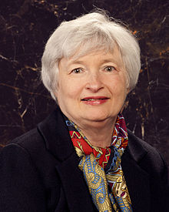
Chair of the Federal Reserve System
Spokesperson for the entire Federal Reserve System
Negotiates, as needed, with Congress and the President of the United States
Sets the agenda for FOMC meetings
With these, the chair has effective control over the system, even though he doesn’t have legal authority to exercise control over the system and its member banks.
Jerome Powell was confirmed as Chair of the Fed on February 5, 2018, for a four-year term. His predecessors were Janet Yellen Ben Bernanke (2006 to 2014); Alan Greenspan (1987 to 2006); and Paul Volcker (1979 to 1987).
Notes:
The Chairman of the Board of Governors of the Federal Reserve System is the head of the central banking system of the United States and one of the most important decision-makers in American economic policies. The Chairman is the "active executive officer" (see 12 U.S.C. § 242) of the Board of Governors of the Federal Reserve System, which is an independent agency of the United States Government created by statute (see 12 U.S.C. § 241), as part of the Federal Reserve System.
The position was created in 1914. The chairman is appointed for a four-year term by the President of the United States (subject to Senate confirmation). In practice, the chairman is often re-appointed several times. The chairman reports twice a year to Congress on the Federal Reserve's monetary policy objectives, testifies before Congress on numerous other issues, and meets periodically with the Secretary of the Treasury.
As of August 2006, the chairman is Ben Bernanke, appointed by George W. Bush and sworn into office on February 1, 2006 for a term lasting until 2010. Bernanke succeeded Alan Greenspan, who served for more than 18 years under four U.S. Presidents.
The law applicable to the Chairman and all other members of the Board provides (in part):
No member of the Board of Governors of the Federal Reserve System shall be an officer or director of any bank, banking institution, trust company, or Federal Reserve bank or hold stock in any bank, banking institution, or trust company; and before entering upon his duties as a member of the Board of Governors of the Federal Reserve System he shall certify under oath that he has complied with this requirement, and such certification shall be filed with the secretary of the Board.
Volcker's Fed is widely credited with ending the United States' stagflation crisis of the 1970s by limiting the growth of the money supply, abandoning the previous policy of targeting interest rates. Inflation, which peaked at 13.5% in 1981, was successfully lowered to 3.2% by 1983 and has remained low ever since [1]. The change in policy contributed to the significant recession the US economy experienced in the early 1980s, which included the highest unemployment levels since the Great Depression. From 1969 to 1974 Mr. Volcker served as under-secretary of the Treasury for international monetary affairs. He played an important role in the decisions surrounding the US decision to suspend gold convertibility in 1971, which resulted in the collapse of the Bretton Woods system. In general he acted as a moderating influence on policy, advocating the pursuit of an international solution to monetary problems. After leaving the US Treasury, he became president of the Federal Reserve Bank of New York from 1975 to 1979, leaving to take up the chairmanship of the Federal Reserve in August 1979.
Jerome H. Powell took office as Chairman of the Board of Governors of the Federal Reserve System on February 5, 2018, for a four-year term. Mr. Powell also serves as Chairman of the Federal Open Market Committee, the System's principal monetary policymaking body. Mr. Powell has served as a member of the Board of Governors since taking office on May 25, 2012, to fill an unexpired term. He was reappointed to the Board and sworn in on June 16, 2014, for a term ending January 31, 2028.

Slide 103
Federal Open Market Committee (FOMC)
Consists of: 7 members of the BOG + President of the Fed Bank of NY + 4 other Fed Bank presidents (in turns, the other 7 attend the meetings but don’t vote). The chair of the BOG is also the chair of this committee
Makes decisions regarding open market operations, to influence the monetary base
FOMC key focal point of the policymaking of the Fed given the key role of open market operations
Often referred to as “the Fed” in the press

Slide 104
Federal Open Market Committee (FOMC) (Cont)
Meet eight times each year (about every six weeks)
Important agenda items include
Reports on open market operations (foreign and domestic)
“Go-round” and review of green, blue and beige books
Discussion of monetary policy and directives, including views of each member
Formal policy directive made
Post-meeting announcements, as needed
FOMC issues directives to the trading desk at the Fed Bank of NY where open market operations are executed
Notes:
When the media says that “the Fed is meeting” they actually means the FOMC.
FOMC consists of the 7 members of the BOG + the president of the Fed of NY + presidents of 4 other fed Banks.

Slide 105
How Independent is the Fed?
Current issue: the level of independence of the Fed has been questioned again as result of the current crisis; and by President Trump publicly disagreeing with Chairman Powell over the direction of monetary policy
2 aspects of central bank independence:
Instrument Independence: the ability of the central bank to set monetary policy instruments.
Goal Independence: the ability of the central bank to set the goals of monetary policy.
Most economists argue that the Fed is free along both dimensions, although some disagree
Normally, the 14-year terms (non-renewable) limit incentives to curry favor with either the President or Congress.
The Fed is usually generates revenue in excess of its expenses, so it is not typically under appropriations pressure.
However, Congress can enact legislation to gain control of the Fed, a threat wielded as needed. For example, the House Concurrent Resolution 133 requires the Fed to announce its objective growth rate for the money supply.
Presidential appointment clearly sets the direction of the Fed.
Notes:
A broad question of policy for the Federal Reserve Systems is how free the Fed is from presidential and congressional pressure in pursuing its goals.
Instrument Independence: the ability of the central bank to set monetary policy instruments.
Goal Independence: the ability of the central bank to set the goals of monetary policy.
Evidence suggests that the Fed is free along both dimensions. Further, the 14-year terms (non-renewable) limit incentives to curry favor with either the President or Congress.
The Fed is usually generates revenue in excess of its expenses, so it is not typically under appropriations pressure.
However, Congress can enact legislation to gain control of the Fed, a threat wielded as needed. For example, the House Concurrent Resolution 133 requires the Fed to announce its objective growth rate for the money supply.
Presidential appointment clearly sets the direction of the Fed.
Why the Fed will struggle to stay above the fray
Source: Sylvester Eijffinger and Edin Mujagic, http://www.ft.com/cms/s/0/b4b23efa-b15a-11de-b06b-00144feabdc0.html?ftcamp=rss, Published: October 5 2009 03:00
Although many argue that the Fed is an independent central bank, we do not agree. The Fed is independent within government and, as such, only partially so. The Federal Reserve Act may be changed by a simple majority in the US Congress. The statutes of the European Central Bank, by contrast, can only be changed if all 27 European Union member states agree. This would surely be a complicated process as countries such as Germany and the Netherlands can be counted on always to resist such a move. In the first place, the nomination of Mr. Bernanke for a second term is not a cause for relief regarding threats to the Fed's independence; on the contrary, it is more a sign of distress. Under his leadership, the central bank's independence has suffered. Examples of this are the extreme quantitative easing by the Fed and the political pressure to continue with this. One might say that Mr. Bernanke was nominated because the positive effects on output are visible, while the negative effects on inflation are not.
Second, and perhaps more worrying, is the fact that Mr. Obama has the opportunity to appoint almost the entire board of governors at the Fed within his first term. The board consists of seven members or, more precisely, it should consist of seven members. Since April 2006 the Fed has been sailing though the rough waters of the financial and economic crisis with only five governors (…).
The consequence is that Mr. Obama can nominate two governors to the board instantly, if he so desires. But it does not stop there. The non-renewable term of Donald Kohn, vice-chairman, expires next June, meaning that Mr. Obama can soon start looking for his replacement. Another governor appointed by Mr. Bush, Elisabeth Duke, will leave the board in 2011 when her term expires. Given that Mr. Obama has already made one other appointment to the board, that of Daniel Tarullo in late January, the grand total of Obama nominees would then come to six out of seven governors, Mr. Bernanke included. Only one, the 39-year old Kevin Warsh, a former investment banker and former adviser to Mr. Bush, has a safe seat. His term does not expire until 2018.
Not only will Mr. Obama be able to nominate four governors, a majority, in his first two years, but the Obama-dominated board also has the final say in the appointments of the presidents of the 12 regional Federal Reserve banks (…).
That is worrying as research shows that when presidential popularity is declining, the incumbent is likely to influence the Fed to stimulate the economy by keeping interest rates low.

Slide 106
Summary
Link between banking regulations and monetary policy
What is central banking
The Fed:
Role and responsibilities
Federal Reserve System composition
Fed functions
Member banks;
Board of Governors
FOMC
Central banking independence

Slide 107
Test Your Understanding
The government organization responsible for the conduct of monetary policy in the United States is the U.S. Treasury.
True
False
The Federal Open Market Committee consists of
The five senior members of the seven-member Board of Governors.
The seven members of the Board of Governors and seven presidents of the regional Fed banks.
The seven members of the Board of Governors and five presidents of the regional Fed banks.
The twelve regional Fed bank presidents and the chairman of the Board of Governors.

Slide 108
Course Map
Overview
Regulations
Banking Regulation
1. The Federal Reserve System
2. Foreign Central Banks
3. Monetary Policy
Monetary Policy
Spring 10

Slide 109

European Central Bank
Who is the President of the ECB?
Founded on 1 June 1999 , HQ in Frankfurt
The ECB is governed by the Executive Board, headed by a President, and a Governing Council, consisting of the six members of the board and the governors of the national central banks of the 19 euro area countries.
The Executive Board consists of six members which are elaborating the strategies for the bank's policy. They are appointed by the European Council, acting by a qualified majority.
The Governing Council is the main decision-making body of the ECB; it formulates monetary policy for the euro area.
The most instrument and goal independent central bank in the world. It was given independence in the treaty, and that policy can only be changed by amending the treaty.
The ECB Tower in Frankfurt
Source: Wikipedia
Notes:
The Governing Council is the main decision-making body of the ECB. It consists of the six members of the Executive Board, plus the governors of the national central banks of the 19 euro area countries (source: ECB http://www.ecb.europa.eu/ecb/orga/decisions/govc/html/index.en.html )
http://www.ecb.europa.eu/ecb/orga/decisions/govc/html/index.en.html
European Central Bank (ECB)
(Source: Wikipedia)
Founded on 1 June 1999 by a treaty between the European Central Bank (ECB) and the European System of Central Banks (ESCB).
Board of directors consists of the president, vice president, and four members, all serving eight-year terms.
The policy group consists of the executive board and governors from the 19 member countries central banks.
The ECB is the most instrument and goal independent central bank in the world. It was given independence in the treaty, and that policy can only be changed by amending the treaty.
The European Central Bank (ECB) (also in other languages) is one of the world's most important central banks, responsible for monetary policy covering the 13 member countries of the Eurozone.
The ECB was established on June 1, 1998 and its headquarters are located in Frankfurt, Germany.
The organisation of the ECB is modelled on that of the German Bundesbank and Landesbanken.
President of the European Central Bank
(Source: Wikipedia article: List of Presidents of the European Central Bank)
In 1999 Wim Duisenberg, the former president of De Nederlandsche Bank, and former finance minister of the Netherlands became the first president of the ECB.
In November 2003 Jean-Claude Trichet succeeded and finished his term in 2011
Mario Draghi was chosen to become the next President of the ECB on the 24 June 2011.^{[8]}
He was succeeded by Christine Lagarde on 1 Nov 2019
European System of Central Banks
The European System of Central Banks (ESCB) is comprised of the European Central Bank (ECB), and the local Central banks of the 27 member states of the European Union. Only governors from national banks inside the eurozone take part and are responsible for the decision-making process.
Objectives
The primary objective of the ECB, and the wider ESCB, is "to maintain price stability" within the euro area, i.e., to keep inflation low. The present target is to keep inflation below, but close to, 2%.
In addition, and without prejudice to the objective of price stability, the bank has to support the economic policies of the European Union. These are designed to foster a high level of employment and sustainable and non-inflationary economic growth under Article 2 of the Treaty of the European Union (otherwise known as the Maastricht Treaty).
Tasks
The major task of the ECB is to maintain a monetary policy for the euro area in pursuit of the objectives set out above. The current monetary policy is published on the ECB website.
It has several tools for this purpose:
Main refinancing operations, in which money is injected into the banking system as an auction.
Deposit facility: private banks depositing overnight.
Marginal lending facility: ECB lending to private banks overnight.
In addition to monetary policy the ECB's other tasks are:
The conduct of foreign exchange operations and the holding and management of the official foreign reserves of the eurozone countries. Official reserves total over €40 billion of which over 30% are gold reserves of the Bundesbank and around 20% of the Banque de France. All gold and foreign exchange reserves of the national central banks remain their assets but, under the Maastricht treaty, are at the disposal of the ECB.
The promotion of the smooth operation of payment systems.
The following are described by the ECB as 'further tasks':
Banknotes: the ECB has the exclusive right to authorize the issuance of banknotes within the euro area.
Statistics: in cooperation with the National Central Banks, the ECB collects statistical information necessary for fulfilling the tasks, either from national authorities or directly from economic agents.
Financial stability and supervision: the Eurosystem contributes to the smooth conduct of policies pursued by the authorities in charge related to the prudential supervision of credit institutions and the stability of the financial system.
International and European cooperation: the ECB maintains working relations with relevant institutions, bodies and for both within the EU and internationally in respect of tasks entrusted to the Eurosystem.
There are two main criticisms of the ECB:
Inflation target
Many economists have stated the ECB should adopt a symmetrical inflation target, much like the one the Bank of England follows.[1] The Bank of England's inflation target is 2% plus or minus 1%, whilst the ECB's 'below but close to 2%', is less clearly defined.
Some critics think the objectives given to the ECB are inappropriate. The ECB sets interest rates in order to control inflation. Some feel this too narrow an objective, leading to decisions on interest rates that are inappropriate given the wider needs of the economy. This kind of criticism about what targets should be used, are made of many central banks and not just the ECB.
The low interest rates set by the ECB have been criticized as being inappropriate for regions of Europe with property bubbles. These low interest rates are a factor in the Irish property bubble. Low rates have been set to avoid deflation in the eurozone as a whole.
Independence
The ECB was established as a central bank designed to operate independently of political intervention. Its objectives and powers were politically established, but decisions on how those powers are best used to achieve the objectives are left in the hands of the ECB itself, this is known as operational independence. Many national banks in the EU are outside the eurozone and independent, e.g. the Danmarks Nationalbank or the Bank of England and also have similar arrangements.
There is a consensus amongst economists that an independent central bank is the best way to avoid manipulation of the macroeconomy for political purposes [citation needed].
Some see the ECB's independence as undemocratic and criticise the decision-making processes and objectives of the ECB, asserting that the ECB is hard-wired to be secretive and independent from most citizens of the European Union, and to be isolated from feedback mechanisms regarding the influence of the money economy on human rights violations or the natural environment.
The ECB does not publish or invite comments on its proposed decisions . After publication of its actions and decisions, ECB web pages do not solicit direct comments by citizens. It is thought that details of internal meetings are not made public in order not to reveal internal splits in the board of governors.
The ECB is accountable to the European Parliament and the Council of ministers. The council appoints the ECB president and vice-president and other members of the ECB's executive board. The nominees must be approved by Parliament first, and then by the council of ministers before they can assume their roles in the institution. It is required by law for the ECB president to present an annual report to the plenary sitting of Parliament. Furthermore, the ECB president or their deputy reports to the Parliament's monetary affairs committee four times a year; this can be more frequent at either the Parliament's or the ECB's request.
European citizens may influence the policy decisions of the ECB indirectly via the formal, national democratic electoral process. However, if changes in economic assumptions are expressed via formal democratic means, elected politicians may have little power to directly transmit these changes to the ECB.

Slide 110

Bank of England
Founded in 1694 the Bank of England was nationalized in 1946 and gained independence in 1997
The 1998 Bank of England Act provided the current organizational framework, consisting of:
The Court of Directors (the “Court”) manages the Bank’s affairs, other than monetary policy
Like BOG consists of the Governor, two Deputy Governors and 16 nonexecutive Directors
Source: www.freefoto.com

Slide 111
Bank of England (Cont)
Who is the current Governor of the BoE?
The NedCo is a sub-committee of Court consisting of all the non-executive directors and a chairman designated by the Chancellor of the Exchequer
The Monetary Policy Committee (“MPC”) has responsibility for monetary policy. The MPC meets at least monthly
Like FOMC consists of the Governor, Deputy Governors, two of the Bank’s Executive Directors, plus four members appointed by the Chancellor.
Source: www.freefoto.com
Notes:
The Bank of England is the central bank of the United Kingdom. Sometimes known as the 'Old Lady' of Threadneedle Street, the Bank was founded in 1694, nationalised on 1 March 1946, and gained independence in 1997. Standing at the centre of the UK's financial system, the Bank is committed to promoting and maintaining monetary and financial stability as its contribution to a healthy economy. The current governance and accountability framework is set by the 1998 Bank of England Act, which provides for a Court of Directors, a Committee on Non-executive Directors within Court, and a Monetary Policy Committee.
Governor is Andrew Bailey
The Court of Directors
Court consists of the Governor, two Deputy Governors and 16 Directors. The Directors are all non-executive. The Governors are appointed by the Crown for five years and the Directors for three years. Details of the current Court can be found in the Bank's Annual Report.
Under the Act, the responsibilities of Court are to manage the Bank's affairs, other than the formulation of monetary policy, which is the responsibility of the Monetary Policy Committee. This includes determining the Bank's objectives and strategy, and aiming to ensure the effective discharge of the Bank's functions and the most efficient use of the Bank's resources.
The Monetary Policy Committee (MPC)
The Bank of England Act establishes the MPC as a Committee of the Bank, subject to the oversight of NedCo, and sets a framework for its operations. Under the Act, the Bank's objectives in relation to monetary policy are to maintain price stability and, subject to that, to support the Government's economic policies, including its objectives for growth and employment. At least once a year, the Government specifies the price stability target and its growth and employment objectives. The MPC must meet at least monthly; its members comprise the Governor and Deputy Governors, two of the Bank's Executive Directors and four members appointed by the Chancellor. The MPC's decisions are announced after each monthly meeting and minutes of their meetings are published two weeks later. The quarterly Inflation Report includes the MPC's projections of inflation and output.
NedCo
The Act provides for a sub-committee of Court ("NedCo") consisting of all the non-executive Directors, with a chairman designated by the Chancellor of the Exchequer. The chairman of NedCo is also Deputy Chairman of Court. NedCo has responsibilities for reviewing the Bank's performance in relation to its objectives and strategy, and monitoring the extent to which the Bank's financial management objectives are met. NedCo is also responsible for reviewing the procedures of the MPC, and in particular whether the Committee has collected the regional, sectoral and other information necessary for formulating monetary policy. Other functions of NedCo - in which it is supported by the Audit, Risk and Remuneration Committees - include reviewing the Bank's internal controls and determining the Governor's and Deputy Governor's remuneration and the terms and conditions of service of the four members of the MPC appointed by the Chancellor. NedCo is required to make a report as part of the Bank's Annual Report.
Since 2004 the normal practice has been for the business of Court to be discussed in an extended meeting of NedCo, with the Executive present.
Formal decisions are then taken in Court. NedCo also holds meetings from time to time without the Executive, so that it can fulfil its reviewing role.

Slide 112
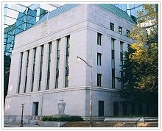
Bank of Canada
Who is the current Governor of the BoC?
Founded in 1934
Directors are appointed by the government for three-year terms, and they appoint a Governor for a seven-year term.
A governing council is the policy-making group comparable to the FOMC.
In 1967, ultimate monetary authority was given to the government. However, this authority has never been exercised to date.
Notes:
Tiff Macklem, Governor of Bank of Canada (http://www.bank-banque-canada.ca/en/about/council.html ) (2020 - present) mandate expires June 2027
The Bank of Canada is the nation's central bank. We are not a commercial bank and do not offer banking services to the public. Rather, we have responsibilities for Canada's monetary policy, bank notes, financial system, funds management. Our principal role, as defined in the Bank of Canada Act, is "to promote the economic and financial welfare of Canada."
A special type of Crown Corporation
The Bank was founded in 1934 as a privately owned corporation. In 1938, it became a Crown corporation belonging to the federal government. Since that time, the Minister of Finance has held the entire share capital issued by the Bank. Ultimately, the Bank is owned by the people of Canada.
The Bank is not a government department and conducts its activities with considerable independence compared with most other federal institutions. For example:
The Bank's Headquarters
The Bank's Ottawa headquarters were designed by renowned Canadian architect Arthur Erickson in 1969 ... more: http://www.bankofcanada.ca/en/about/hq.html
History
The Bank of Canada opened its doors in 1935 ... more: http://www.bankofcanada.ca/about/who-we-are/history/?page_moved=1

Slide 113

Bank of Japan
Who is the current Governor of the BoJ?
Founded in 1882
The Policy Board sets monetary policy, and consists of the Governor, two Vice Governors, and six outside members. All serve five-year terms.
The Bank of Japan Law (1998) gave the Bank considerable instrument and goal independence.
Japan’s Ministry of Finance can exert authority through its budgetary approval of the Bank’s non-monetary spending.
Headquarters of the Bank of Japan in Tokyo
Source: Wikipedia
Notes:
Haruhiko Kuroda, Governor of BoJ (http://www.boj.or.jp/en/type/list/pb_member/shirakawa.htm ) (2013 - present)
The Bank of Japan was founded in Meiji 15 (1882) and given a monopoly on controlling the money supply.
The Bank of Japan issued its first banknotes on Meiji 18 (1885), and despite some small glitches -- for example, it turned out that the konnyaku powder mixed in the paper to prevent counterfeiting made the bills a delicacy for rats -- the run was largely successful. In 1897 Japan joined the gold standard and in 1899 the former "national" banknotes were formally phased out.
The Bank of Japan has continued ever since, with the exception of a brief post-WW2 hiatus when the occupying Allies issued military currency and restructured the Bank into a more independent entity. However, despite a major 1997 rewrite of the Bank of Japan Law (日本銀行法) intended to give it more independence, the Bank of Japan has been criticized for lack of independence. A certain degree of dependence is enshrined in the Law itself, article 4 of which states:
In recognition of the fact that currency and monetary control is a component of overall economic policy, the Bank of Japan shall always maintain close contact with the government and exchange views sufficiently, so that its currency and monetary control and the basic stance of the government's economic policy shall be mutually harmonious.
According to its charter, the missions of the Bank of Japan are:
Issuance and Management of Banknotes
Implementation of Monetary Policy
Providing Settlement Services and Ensuring the Stability of the Financial System
Treasury and Government Securities-Related Operations
International Activities
Compilation of Data, Economic Analyses and Research Activities
The chief of the bank (総裁, sōsai) has considerable influence on the economic policy of the Japanese government. Toshihiko Fukui replaced Masaru Hayami as the governor of the Bank of Japan since March 2003.

Slide 114
Central Banking in Asia: what are the most recent developments?
Group 19
Video
https://www.youtube.com/watch?v=s4tSP9-o7ZQ
Article
https://asb.edu.my/2021/01/12/understanding-the-digital-currency-landscape-in-asia-and-beyond

Slide 115
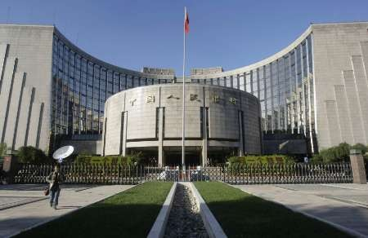
People’s Bank of China
Established in 1948, became China’s central bank in 1983
The Law of the People's Republic of China on the People's Bank of China was adopted on March 18, 1995 by the 3rd Plenum of the 8th National People's Congress
PBOC reports to the State Council and to the Standing Committee of the National People’s Congress
The top management of the PBC is composed of the governor and a certain number of deputy governors.
The PBC headquarters in Beijing

Slide 116
People’s Bank of China (Cont)
The governor of the PBC is appointed into or removed from office by the President of the People's Republic of China. The candidate for the governor of the PBC is nominated by the Premier of the State Council and approved by the National People's Congress.
The deputy governors of the PBC are appointed into or removed from office by the Premier of the State Council.
The PBC headquarters in Beijing
Who is the current Governor of the PBC?
Notes:
Image Source: http://ca.ibtimes.com/articles/106427/20110128/china-surplus-to-fall-more-in-2011-pboc-aide-davos.htm
Source: http://www.pbc.gov.cn/english/
Yi Gang
The People's Bank of China (PBC) was established on December 1, 1948 based on the consolidation of the Huabei Bank, the Beihai Bank and the Xibei Farmer Bank. In September 1983, the State Council decided to have the PBC function as a central bank. The Law of the People's Republic of China on the People's Bank of China adopted on March 18, 1995 by the 3rd Plenum of the 8th National People's Congress has since legally confirmed the PBC's central bank status.
With the improvement of the socialist market economic system, the PBC, as a central bank, will play an even more important role in China's macroeconomic management. The amended Law of the People's Republic of China on the People's Bank of China, adopted by the 6th meeting of the Standing Committee of the 10th National People's Congress on December 27, 2003, provides that the PBC performs the following major functions:
Drafting and enforcing relevant laws, rules and regulations that are related to fulfilling its functions;
Formulating and implementing monetary policy in accordance with law;
Issuing the Renminbi and administering its circulation;
Regulating financial markets, including the inter-bank lending market, the inter-bank bond market, foreign exchange market and gold market;
Preventing and mitigating systemic financial risks to safeguard financial stability;
Maintaining the Renminbi exchange rate at adaptive and equilibrium level; Holding and managing the state foreign exchange and gold reserves;
Managing the State treasury as fiscal agent;
Making payment and settlement rules in collaboration with relevant departments and ensuring normal operation of the payment and settlement systems;
Providing guidance to anti-money laundering work in the financial sector and monitoring money-laundering related suspicious fund movement;
Developing statistics system for the financial industry and responsible for the consolidation of financial statistics as well as the conduct of economic analysis and forecast
Administering credit reporting industry in China and promoting the building up of credit information system;
Participating in international financial activities at the capacity of the central bank;
Engaging in financial business operations in line with relevant rules;
Performing other functions prescribed by the State Council.
Institutional Arrangement
Under the leadership of the State Council, the PBC implements monetary policy, performs its functions and carry out business operations independently according to laws and free from intervention by local governments, government departments at various levels, public organizations or any individuals.
The PBC needs to report to the State Council its decisions concerning the annual money supply, interest rates, exchange rates and other important issues specified by the State Council for approval before they are put into effect. The PBC is also obliged to submit work report to the Standing Committee of the National People's Congress on the conduct of monetary policy and the performance of the financial industry.
All capital of the PBC is invested and owned by the State.
Management and Organizational Structure
The top management of the PBC is composed of the governor and a certain number of deputy governors. The governor of the PBC is appointed into or removed from office by the President of the People's Republic of China. The candidate for the governor of the PBC is nominated by the Premier of the State Council and approved by the National People's Congress. When the National People's Congress is in adjournment, the Standing Committee of the National People's Congress sanctions the candidacy for the governor of the PBC. The deputy governors of the PBC are appointed into or removed from office by the Premier of the State Council.
The PBC adopts a governor responsibility system under which the governor supervises the overall work of the PBC while the deputy governors provide assistance to the governor to fulfill his or her responsibility.
The head office of the PBC is located in Beijing, the nation's capital and consists of 18 functional departments (bureaus).

Slide 117
China’s financial reforms: deposit insurance
PBOC implements China’s first national deposit insurance
The People’s Bank of China implemented its Deposit Insurance Act, on May 1, 2015.
All deposit-taking financial institutions in China, excluding branch offices of foreign banks in China, are covered by the act.
National deposit insurance covers a maximum of Rmb500,000 per depositor per bank, including equivalent foreign currency deposits.
The PBOC estimates the new system will provide full protection for 99.63% of depositors

Slide 118




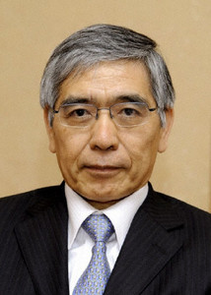
Who is who?
1
2
3
5
4
Notes:
Andrew Bailey, Governor of BofE (https://www.bankofengland.co.uk/about/people/governors) (2020 - present) mandate expires March 2028
Tiff Macklem, Governor of Bank of Canada (http://www.bank-banque-canada.ca/en/about/council.html ) (2020 - present) mandate expires June 2027
Christine Lagarde, president of ECB (http://www.ecb.int/ecb/orga/decisions/eb/html/ebbig.en.html ) (2019- present)
Haruhiko Kuroda, Governor of BoJ (http://www.boj.or.jp/en/type/list/pb_member/shirakawa.htm ) (2013 - present)
Yi Gang, Governor, PBOC (https://en.wikipedia.org/wiki/Yi_Gang) (2018 - present)

Slide 119





Comparison of Asian central banks monetary policy goal & tool sets
Core Objectives (Goals) | Currency stability under the Linked Exchange Rate System | Economic growth Stable prices Increased employment BoP equilibrium Financial stability | Exchange rate stability
Independence
Regulator
Policy Tools Used In the Millennium | Exchange Fund Bills (in terms of tenders) Base rate adjustment Settlement facilities (Intraday Repo and Discount window) Regulated Capital Ratios | Open market operations(reverse repos, spot bond transactions, central bank bill, SLO, CBS) Reserve requirement Central bank lending(re-lending, rediscount) Interest rate policy Standing Lending Facility(SLF) Medium-term Lending Facility(MLF) Pledged Supplementary Lending(PSL) Targeted Medium-term Lending Facility(TMLF) | Exchange rate policy band adjustment (slope, width and level of policy band located) Liquidity Facilities MAS Bills MAS floating rate notes Emergency Liquidity Assistance Singapore overnight rate average

Slide 120

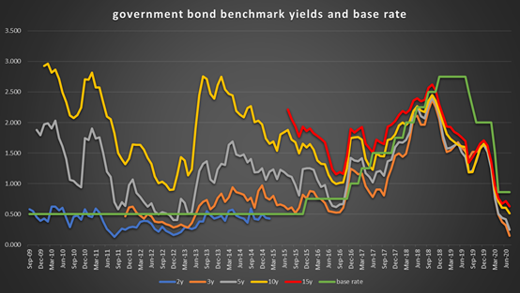
Comparison of Asian central banks monetary policy goal & tool sets
Tools deployed during Covid-19 | Reduced CCyB* by 1.5% to 1% Cut Regulatory Reserve by half Set up liquidity facilities Reduced Exchange Fund Bills issuance | Cut reserve requirement ratio (RRR) three times Used open market operations to inject short-term liquidity and reduced the reverse repo interest rate Carried out CBS operations continuously and issued central bank bills in Hong Kong on a regular basis Conducted SLF & MLF operations and lowered the relevant interest rates, fueling the drop of LPR Set up special re-lending and re-discount quotas and lowered the relevant interest rates | •Adjusted the slope and level of exchange rate policy band adjustment •Provided $US60 billion of liquidity to banks through swap facilities with US Fed Reserve •Lowered interest rate and deferred payment of principal on SME loans
Overlap between fiscal & monetary policy

Slide 121
Summary
Basic information about major foreign central banks
Goals of HKMA, MAS and PBOC

Slide 122
Test Your Understanding
Which of the following central banks has the greatest degree of independence?
Bank of England
European Central Bank
Bank of Japan
Federal Reserve System
Which of the following does not have currency stability as its main goal?
HKMA
MAS
PBOC

Slide 123
Course Map
Overview
Regulations
Banking Regulation
1. The Federal Reserve System
2. Foreign Central Banks
3. Monetary Policy
Monetary Policy
Spring 10

Slide 124
Fiscal & Monetary Policy
Government
Monetary
Policy
Fiscal
Policy
Financial
Authorities
Demand for
Goods and
services
Money
supply
Interest
rates
Inflation
Ultimate economic
goals
Notes:
This chart looks at the influence of government on ultimate economic goals through fiscal and monetary policy
Monetary Policy
Financial authorities, generally the central bank (may in some cases be “independent” from the government)
Control of interest rates
Control of money supply
Fiscal Policy
Government
Control of taxes
Monetary policy = the management of money and interest rates. Generally the Central Bank is responsible for monetary policy.
Goals of monetary policy may include: high employment, economic growth, price stability, interest rate stability, stability of financial markets and stability in FX markets
Monetary policy refers to the actions of central banks to achieve macroeconomic policy objectives such as price stability, full employment, and stable economic growth. Fiscal policy refers to the tax and spending policies of the federal government. Fiscal policy decisions are determined by the Congress and the Administration; the Fed plays no role in determining fiscal policy.
Price level and money supply generally move closely together  increase in money supply  increase in price level (inflation). Milton Friedman: “inflation is always and everywhere a monetary phenomenon”
Inflation is a continual increase in the aggregate price level. Inflation rate is the rate of change of the price level, measured as a percentage change per year.
Aggregate price level = average price of goods and services in the economy.
Measures of aggregate price level include the GDP deflator (nominal GDP divided by real GDP) and consumer price index or CPI which is measured by pricing a basket list of goods & services bought by a typical urban household over a given period. The CPI is also expressed as a price index with the base year equal to 100
Real versus Nominal:
Nominal = values measured using current prices;
Real = values measured in terms of fixed prices.
Nominal GDP = total value of final goods and services calculated using current prices
Real GDP = GDP measured using constant prices (in terms of prices for an arbitrary base year, in the US currently 1996).
Business cycles are upward and downward movements of aggregate output. Recessions are cycles when the aggregate output is declining; expansions are cycles when the aggregate output is increasing.
Aggregate (economic) output = total production of goods and services. Most common measures are GDP and GNP
GDP (gross domestic product, or value of final goods and services produced in an economy during the course of the year)
GNP (gross national product, or value of all final goods and services produced by domestically owned factors of production in a year).

Slide 125

Goals of Monetary Policy
Federal Reserve Act: “to promote effectively the goals of maximum employment, stable prices, and moderate long-term interest rates”
High employment
Economic growth
Price stability
Interest rate stability
Financial market stability
Foreign exchange market stability
Goals often conflict!
Notes:
The goals of monetary policy include the promotion of sustainable economic growth, full employment, and stable prices. Through monetary policy, the fed is most able to maintain stable prices, thereby promoting economic growth and maximum employment (from Fed’s website).
The goals of monetary policy are spelled out in the Federal Reserve Act, which specifies that the Board of Governors and the Federal Open Market Committee should seek “to promote effectively the goals of maximum employment, stable prices, and moderate long-term interest rates.” Stable prices in the long run are a precondition for maximum sustainable output growth and employment as well as moderate long-term interest rates. When prices are stable and believed likely to remain so, the prices of goods, services, materials, and labor are undistorted by inflation and serve as clearer signals and guides to the efficient allocation of resources and thus contribute to higher standards of living. Moreover, stable prices foster saving and capital formation, because when the risk of erosion of asset values resulting from inflation—and the need to guard against such losses - are minimized, households are encouraged to save more and businesses are encouraged to invest more.

Slide 126
Fed Goals (before pandemic)
The Committee’s policy decisions reflect its longer-run goals, its medium-term outlook, and its assessments of the balance of risks, including risks to the financial system that could impede the attainment of the Committee’s goals
Inflation (stable prices): The Committee reaffirms its judgment that inflation at the rate of 2 percent, as measured by the annual change in the price index for personal consumption expenditures, is most consistent over the longer run with the Federal Reserve’s statutory mandate
Employment: FOMC participants’ estimates of the longer-run normal rate of unemployment had a central tendency of 5.2 percent to 5.5 percent.
Source: Fed
Notes:
Source: Fed http://www.federalreserve.gov/monetarypolicy/files/FOMC_LongerRunGoals.pdf
(retrieved 15 April 15 at 5:42pm)

Slide 127
New Fed Goals (post-Pandemic)
Maximum employment
the highest level of employment or lowest level of unemployment that the economy can sustain while maintaining a stable inflation rate
the Fed seeks to mitigate shortfalls of employment from assessments of its maximum level.
Stable prices
the FOMC seeks to achieve inflation that averages 2 percent over time
The Federal Open Market Committee (FOMC) judges that inflation rate of 2 percent over the longer run, as measured by the annual change in the price index for personal consumption expenditures, is most consistent with the Federal Reserve’s mandate.
Notes:
Source: Fed https://www.federalreserve.gov/faqs/what-economic-goals-does-federal-reserve-seek-to-achieve-through-monetary-policy.htm#:~:text=The%20Federal%20Reserve%20works%20to,moderate%20long%2Dterm%20interest%20rates.
What economic goals does the Federal Reserve seek to achieve through its monetary policy?
The Federal Reserve works to promote a strong U.S. economy. Specifically, the Congress has assigned the Fed to conduct the nation’s monetary policy to support the goals of maximum employment, stable prices, and moderate long-term interest rates. When prices are stable, long-term interest rates remain at moderate levels, so the goals of price stability and moderate long-term interest rates go together. As a result, the goals of maximum employment and stable prices are often referred to as the Fed’s “dual mandate.”
Maximum employment is the highest level of employment or lowest level of unemployment that the economy can sustain while maintaining a stable inflation rate. Over the past few decades, experience has shown that it is possible to keep unemployment low and the jobs market strong without leading to an unwanted increase in inflation. For example, in the economic expansion following the Great Recession, as unemployment fell below estimates of what was thought to be sustainable, the jobs market proved remarkably adaptable. This resulted in many benefits and opportunities to families and communities that all too often had been left behind. Building on that, a low level of unemployment, absent other risks, will not by itself be a cause for concern. Of course, when unemployment is high, the Fed will actively seek to lower it. For this reason, the Fed seeks to mitigate shortfalls of employment from assessments of its maximum level.
Prices are considered stable when consumers and businesses don’t have to worry about rising or falling prices when making plans, or when borrowing or lending for long periods. The Federal Open Market Committee (FOMC) judges that inflation rate of 2 percent over the longer run, as measured by the annual change in the price index for personal consumption expenditures, is most consistent with the Federal Reserve’s mandate. To best achieve this longer-run goal, the FOMC seeks to achieve inflation that averages 2 percent over time. When households and businesses can reasonably expect 2 percent inflation over the longer run helps them make sound decisions regarding saving, borrowing, and investment, thus contributing to a well-functioning economy.

Slide 128
The Federal Reserve’s Balance Sheet
Monetary assets of the Fed
Monetary liabilities of the Fed
Government Securities
Discount Loans
Currency in circulation
Reserves
Conduct of monetary policy involves changes in the assets and liabilities of the Fed system
Source: Mishkin
Notes:
The conduct of monetary policy by the Federal Reserve involves actions that affect its balance sheet. This is a simplified version of its balance sheet, which we will use to illustrate the effects of Fed actions.
The monetary liabilities of the Fed include:
Currency in circulation: the physical currency in the hands of the public, which is accepted as a medium of exchange worldwide.
Reserves: All banks maintain deposits with the Fed, known as reserves. The required reserve ratio, set by the Fed (currently 10% of transaction deposit accounts), determines the required reserves that a bank must maintain with the Fed. Any reserves deposited with the Fed beyond this amount are excess reserves. Since the Fed does not pay interest on reserves, excess reserves are usually kept to a minimum.
Reserves are used to settle accounts between depository institutions when checks and wire transfers are cleared.
Reserve accounts influence the size of the money supply
The monetary assets of the Fed include:
Government Securities: These are the U.S. Treasury bills and bonds that the Federal Reserve has purchased in the open market. As we will show, purchasing Treasury securities increases the money supply.
Discount Loans: These are loans made to member banks at the current discount rate. Again, an increase in discount loans will also increase the money supply.

Slide 129
Balance Sheet of the Federal Reserve (in billions of dollars, 2004)
Assets |  |  | Liabilities and Equity
Gold and foreign exchange | $30.4 |  | Depository institution reserves | $29.6
SDR certificates | 2.2 |  | Vault cash of commercial banks | 43.4
Treasury currency | 36.0 |  | Deposits due to federal government | 6.3
Federal reserve float | 0.2 |  | Deposits due to rest of the world | 0.3
FR loans to domestic banks | 0.3 |  | Currency outside banks | 689.7
Security repurchase agreements | 33.5 |  | Miscellaneous liabilities | 29.3
U.S. Treasury securities | 687.4 |  | FR Bank stock | 9.2
U.S. Government securities | 0.0
Miscellaneous assets | 17.8
Total assets | $807.8 |  | Total liabilities and equity | $807.8
Discount loans
Monetary Base =
Reserves
+
Currency
Source: Saunders/Cornett and Fed
Notes:
Reserves = depository institutions reserve balances at the Fed (includes reserve requirements and excess reserves) plus vault cash
Currently reserve requirement = 10% of daily average net transaction accounts held by a bank over a two week computation period. Transaction accounts include all deposits on which an account holder may make withdrawals (eg demand depos, NOW accounts, share draft accounts)
Money base or monetary base of the fed = currency in circulation plus reserves
Treasury securities are the fed’s holdings of securities issued by the US treasury
The Fed holds Treasury Gold certificates which are redeemable at the US TSY for gold. It also holds small amount of TSY issued coinage and foreign denominated assets to assist in FX transactions or CCY swap agreements with central banks of other nations
Discount loans = loans to domestic banks. Banks can borrow at the Fed’s discount window. Since 2003 the discount rate is always higher than the fed funds rate a

Slide 130
Key role of reserves in monetary policy
Requirement on hold during pandemic
All banks are required to hold reserves at the Fed
Reserves = required reserves (10% of transaction accounts) + excess reserves
Required reserves fluctuate depending on level of transaction deposits
Excess reserves are a liquidity management tool for banks
Reserves are used to settle transactions between depository institutions
Banks with excess reserves lend these to banks in need of reserves = interbank transactions
Rate at which interbank transactions are done = Fed Funds Rate
Fed Funds rate is NOT determined by the Fed; it is a function of the supply and demand for Fed funds among banks and the effects of the Fed’s trading through the FOMC
The initial link in the chain between monetary policy and the economy is the market for balances held at the Federal Reserve Banks
Notes:
The initial link in the chain between monetary policy and the economy is the market for balances held at the Federal Reserve Banks. Depository institutions have accounts at their Reserve Banks, and they actively trade balances held in these accounts in the federal funds market at an interest rate known as the federal funds rate. The Federal Reserve exercises considerable control over the federal funds rate through its inf luence over the supply of and demand for balances at the Reserve Banks.
Some countries don't have reserve requirements. These countries include Canada, the United Kingdom, New Zealand, Australia, Sweden and Hong Kong. Money can't be created without limit, but instead, some of these countries must adhere to capital requirements, which is the amount of capital a bank or financial institution must hold as required by its financial regulator.

Slide 131
Objective of Monetary Policy
To influence the amount of reserves in the banking system…
which affects interest rates and availability of credit and…
ultimately affects the levels of employment, output, prices and inflation
Monetary policy = what the Fed does to influence the amount of money and credit in the US economy
Notes:
The term "monetary policy" refers to what the Federal Reserve, the nation’s central bank, does to influence the amount of money and credit in the U.S. economy. What happens to money and credit affects interest rates (the cost of credit) and the performance of the U.S. economy.
Open market operations are the primary tool used to regulate the supply of bank reserves. This tool consists of Federal Reserve purchases and sales of financial instruments, usually securities issued by the U.S. Treasury, Federal agencies and government-sponsored enterprises. Open market operations are carried out by the Domestic Trading Desk of the Federal Reserve Bank of New York under direction from the FOMC. The transactions are undertaken with primary dealers.
The Fed’s goal in trading the securities is to affect the federal funds rate, the rate at which banks borrow reserves from each other. When the Fed wants to increase reserves, it buys securities and pays for them by making a deposit to the account maintained at the Fed by the primary dealer’s bank. When the Fed wants to reduce reserves, it sells securities and collects from those accounts. Most days, the Fed does not want to increase or decrease reserves permanently so it usually engages in transactions reversed within a day or two. That means that a reserve injection today could be withdrawn tomorrow morning, only to be renewed at some level several hours later. These short-term transactions are called repurchase agreements (repos) – the dealer sells the Fed a security and agrees to buy it back at a later date.

Slide 132
Monetary Policy Tools, old and new
Open Market Operations
The Discount Rate and Discount Loans
Reserve Requirements
Quantitative Easing (I, II, ….) , Tapering and Normalization
Twist
Zero Lower Bound
Forward Guidance
Interest On Excess Reserves (IOER)
Overnight Reverse Repos Program (ORRP)
Traditional Tools
Notes:
On ONRRP: Source Fed: http://www.federalreserve.gov/econresdata/feds/2015/files/2015010pap.pdf

Slide 133
Tools of Monetary Policy: Open Market Operations
Open Market Operations
Advantages of Open Market Operations
Dynamic: Meant to change Reserves
Defensive: Meant to offset other factors affecting Reserves, typically uses repos
Fed has complete control
Flexible and precise
Easily reversed
Implemented quickly
Notes:
Open market operations are the primary tool used to regulate the supply of bank reserves. This tool consists of Federal Reserve purchases and sales of financial instruments, usually securities issued by the U.S. Treasury, Federal agencies and government-sponsored enterprises. Open market operations are carried out by the Domestic Trading Desk of the Federal Reserve Bank of New York under direction from the FOMC. The transactions are undertaken with primary dealers.
The Fed’s goal in trading the securities is to affect the federal funds rate, the rate at which banks borrow reserves from each other. When the Fed wants to increase reserves, it buys securities and pays for them by making a deposit to the account maintained at the Fed by the primary dealer’s bank. When the Fed wants to reduce reserves, it sells securities and collects from those accounts. Most days, the Fed does not want to increase or decrease reserves permanently so it usually engages in transactions reversed within a day or two. That means that a reserve injection today could be withdrawn tomorrow morning, only to be renewed at some level several hours later. These short-term transactions are called repurchase agreements (repos) – the dealer sells the Fed a security and agrees to buy it back at a later date.
Market Operations at the Trading Desk The staff reviews the activities of the prior day and issue forecasts of factors affecting the supply and demand for reserves.
This information is used to determine reserve changes needed to obtain a desired fed funds rate. Government securities dealers are contacted to better determine the condition of the market. Projections are compared with the Monetary Affairs Division of the BOG, and a course of action is determined. Once the plan is approved, the desk carries out the required trades, via the TRAPS system.
Advantages of Open Market Operations
Open market operations are initiated by the Fed, so the volume of these transactions is entirely under the control of the Board of Governors.
The operations are flexible and concise, useful for both small and large changes in the monetary base.
Unanticipated effects are easily reversed, if needed.
Once the course of action is approved, the policy is implements quickly, avoiding administrative delays.

Slide 134
Impact of Open Market Purchase from the public on Fed’s Balance Sheet
Public
Assets |  | Liabilities
Securities | -$100
Deposits | +$100
Fed
Assets |  | Liabilities
Securities | +$100 | Deposits | +$100
Banking System
Assets |  | Liabilities
Reserves | +$100 | Deposits | +$100
Result R ↑ $100, MB $100
Notes:
In the next two slides, we will examine the impact of open market operation on the Fed’s balance sheet and on the money supply. As suggested in the last slide, we will show the following:
Purchase of bonds increases the money supply
Making discount loans increases the money supply
Naturally, the Fed can decrease the money supply by reserving these transactions.

Slide 135
Tools of Monetary Policy: Discount Loans
The Fed’s discount loans are primarily of three types:
Primary Credit: Policy whereby healthy banks are permitted to borrow as they wish from the primary credit facility.
Secondary Credit: Given to troubled banks experiencing liquidity problems.
Seasonal Credit: Designed for small, regional banks that have seasonal patterns of deposits.
NEW: enhanced use of discount windows during GFC and pandemic to prevent liquidity crisis (TAF, broadened collateral, longer terms, wider coverage beyond depository institutions)

Slide 136
Tools of Monetary Policy: Discount Loans
Lender of Last Resort Function
To prevent banking panics - FDIC fund not big enough
Examples: Continental Illinois and Franklin National Bank
To prevent nonbank financial panics
1987 stock market crash
Bear Stearns and AIG bailouts (2008)
pandemic
Announcement Effect
Problem: signals
Notes:
Source: FT 18.03.2008
“Scramble to calm markets”
The US government has agreed to take on any credit losses suffered by the Fed on its $30Bn loan to Bear Stearns. The Fed will employ a private sector group to manage the collateral backing that loan.
“Experts speculate on unorthodox policy measures”
Sunday’s decision by the Fed to offer emergency financing to all its primary dealers – which follows the provision of emergency finance to Bear Stearns on an ad hoc basis - expands the central bank’s role as lender of last resort to cover all the big investments banks. It comes at the cost of exposing the Fed to additional credit risk. This move, and the accompanying halving of the penalty rate on emergency loans, will also make it more difficult for the Fed to manage the key overnight interest rate, the Fed Funds rate, owing to he uncertainty over how much the emergency facility will be used. The action reflects the new Fed doctrine that –a t least at a moment of extreme market fragility – some institutions are too interconnected to fail. This includes the main investment banks that are active participants in the bilateral credit derivatives markets and the triparty repo market. Fed officials note that, while the Fed does not regulate the primary dealers, they are all regulated entities. Officials would be reluctant to extend the provision of emergency facilities to unregulated hedge funds, although they decline to rule it out in all circumstances. The credit risk to the Fed comes mainly through the $30Bn secured, non-recourse loan to Bear Stearns. This is collateralized with some margin, based on marks to market on Friday. The Fed will seek to mitigate these risks by actively managing the collateral portfolio with the help of an unnamed private sector company. It is prepared to hold on to the portfolio for some time in order to get fair value for the collateral and unlike Bear cannot be forced into a fire sale. Fed officials hope the new facility will act as backstop to private markets encouraging primary dealers to continue to make markets in a wide range of securities. But this depends on whether the new facility will carry “stigma”. If investment banks feel that its use will be taken as signal that they are in trouble, they may avoid it, even though user names will not be disclosed. Larry Meyer, former Fed governor, said the Fed was running on a “half tank of gas” because it had already committed $426Bn of its $884Bn portfolio prior to the latest initiative. Fed officials believe that in what they currently see as the unlikely situation that liquidity operations would bump against the $884Bn ceiling they can find ways to bypass that limit. But a growing number of experts believe that the US authorities will have to go further and use public funds to intervene directly in the financial markets –either to guarantee Fannie Mae and Freddie Mac debt, provide large scale alternative guarantees through the Federal Housing Administration – or to purchase mortgages or homes directly. In theory, the Fed could itself intervene in private markets. But most experts believe outright intervention with taxpayers funds would be more properly conducted by the US Treasury.
“Fears of cross-border European crisis grow”
The Bear Stearns crisis has exposed the structural flaws left over from the Glass-Steagall’s regulatory separation of commercial and investments banks. The regulatory system has been evolving far slower than the financial sector – meaning that when crisis strikes, regulators and central banks are forced to create policy on the hoof. Sunday’s decision by the Fed to create an emergency finance facility for primary dealers exposes another problem: the impossibility of denying systemically important investment banks access to emergency liquidity at a time of market crisis. Moreover the current pattern of regulatory fragmentation in the US – another legacy of Glass-Steagall – means the moral hazard problems created by the move is amplified. The net result of Sunday’s decision is that the Fed is providing emergency liquidity to a set of institutions it doesn’t regulate.
“Shock widening in spreads of Fannie and Freddie debt”
Trading in US mortgage markets remained piecemeal yesterday in spite of the Fed’s support for the fire sale of Bear Stearns and its decision to lend directly to investment banks in return for any investment grade collateral. For the first time, securities dealers may borrow from the Fed on much the same terms as banks and in exchange for a broader range of collateral including investment grade corporate securities, municipal bonds, mortgage backed bonds and asset backed securities for which a price is available.

Slide 137
Impact of Discount Lending on the Federal Reserve Balance Sheet
Banking System
Assets |  | Liabilities
Reserves | +$100 | Discount Loans | +$100
Fed
Assets |  | Liabilities
Discount Loans | +$100 | Reserves | +$100
Result R ↑ $100, MB $100

Slide 138
Tools of Monetary Policy: Reserve Requirements
From 2009*, the Fed can pay interest on bank balances held at Reserve Banks
Advantages
Powerful effect
Disadvantages
Small changes have very large effect on Ms
Raising causes liquidity problems for banks
Frequent changes cause uncertainty for banks
Tax on banks
In response to the COVID-19 pandemic, the Federal Reserve reduced the reserve requirement ratio to zero across all deposit tiers, effective March 26, 2020. This aim of this reduction was to jump-start the economy by allowing banks to use additional liquidity to lend to individuals and businesses.
* Date was supposed to be 2016 but was moved forward as result of the crisis

Slide 139
Summary
Monetary v. fiscal policy
MP in the US:
Fed Goals: inflation; unemployment
Fed Balance Sheet
Monetary Base
Reserves
Fed Funds Rate
MP traditional tools
Open Market Operations
Discount Loans
Reserve Requirements

Slide 140
Test Your Understanding
When the Fed uses Open market Operations to buy securities it is planning to _____ interest rates:
Reduce
increase
When the PBOC increases the reserve requirement the interest rates:
Increase
decrease
The ECB is unwinding it asset purchases operations. This is expected to _____ interest rates:
Increase
decrease

Slide 141
Recent tools
Overnight Reverse Repos Program (ON RRP)
Interest On Required and Excess Reserves (IORR and IOER)
Deployed since 2014
The FOMC sets the overnight (ON) Reverse Repurchase (RRP) offering rate, the maximum interest rate the Federal Reserve is willing to pay in an ON RRP operation; the actual interest rate that a counterparty receives is determined through an auction process.
A reverse repurchase agreement “RRP,” is a transaction in which the Fed sells a security to an eligible counterparty with an agreement to repurchase that same security at a specified price at a specific time in the future.
The Federal Reserve conducts ON RRP operations with a wide range of entities
Deployed since 2011
The interest rate on required reserves (IORR rate) is determined by the Board and is intended to eliminate effectively the implicit tax that reserve requirements used to impose on depository institutions.
The interest rate on excess reserves (IOER rate) is also determined by the Board and gives the Federal Reserve an additional tool for the conduct of monetary policy.
The Federal Reserve intends to move the federal funds rate into the target range set by the FOMC primarily by adjusting the IOER rate.
Notes:
Source: Fed
https://www.federalreserve.gov/monetarypolicy/overnight-reverse-repurchase-agreements.htm and https://www.newyorkfed.org/markets/rrp_faq.html
https://www.federalreserve.gov/monetarypolicy/reqresbalances.htm

Slide 142
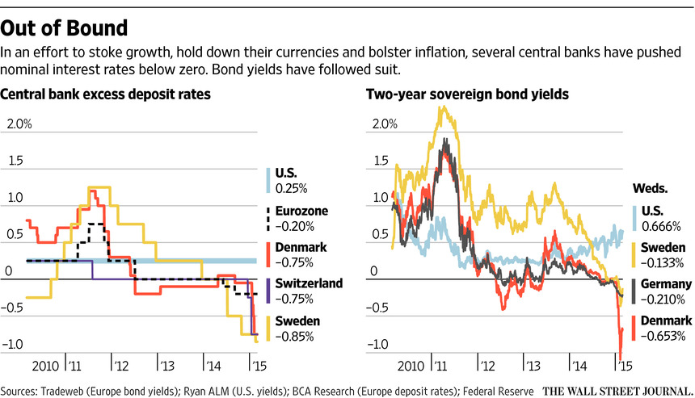
NIRP (not yet deployed in US)….

Slide 143
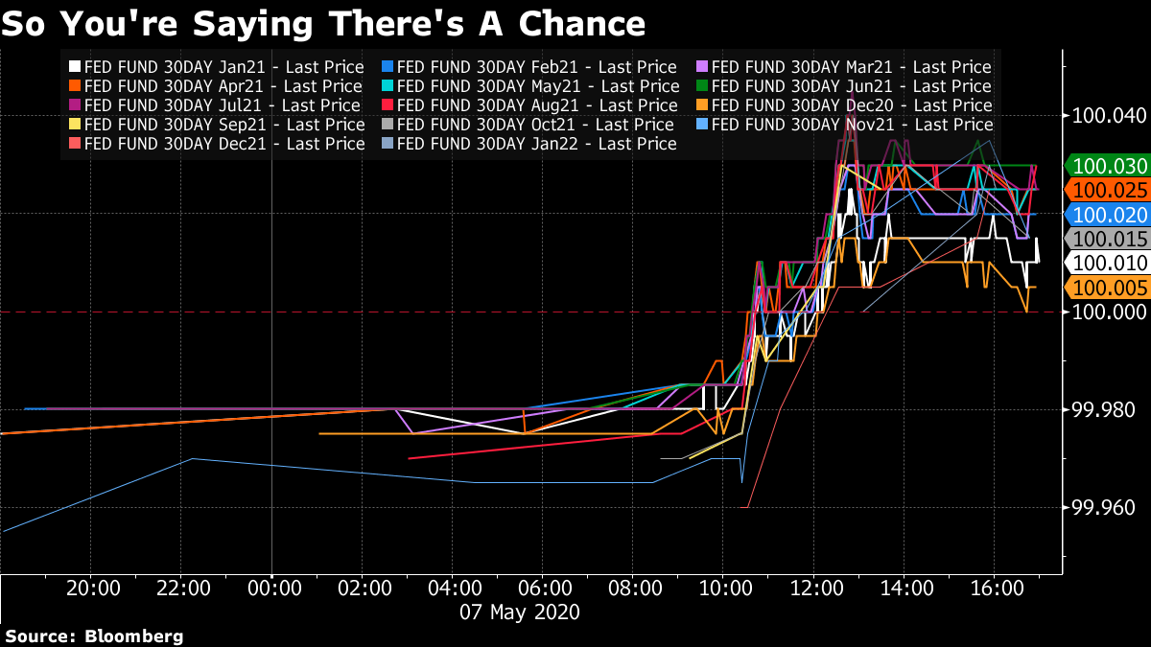
….although….
Notes:
Source: Bloomberg 8 May 2020
Every fed funds futures contract from December 2020 through January 2022 closed above par on Thursday, implying a potential for fractionally negative rates during that timeframe.

Slide 144
Tools deployed during GFC
 | Who | What | Collateral | Duration
TAF | Eligible Depository Institutions | Funds | Full Range of Discount Window Collateral | 28 - 84 days
TSLF | Primary Dealers (PD) | U.S Treasuries | US Treasuries, agencies, agency MBS, investment grade securities | 28 days Effective until April 09 (ext)
PDCF | Primary Dealer | Funds | Full range of tri-party repo | Overnight Effective until April 09 (ext)
MMIFF | Financial Institutions operating Money Market Funds | Funds | First Tier ABCP | ( ~ 3 mths)- Effective until April 09
CPFF | SPV set up by Fed to purchase eligible CP |  | N/A | Effective until April 30, 2009
AMLF | Banking entities | Funds to buy ABCP from MMMF | Eligible ABCP purchased with funds from facility | Effective April 09 (ext.)
TALF | US companies through PD | To enable holders to sell ABS | Investment grade ABS | 3 years Effective until April 09 (ext)
Source: Federal Reserve of New York
Notes:
AMLF = Asset Backed Commercial paper Money Market Mutual Fund Lending Facility
CPFF = Commercial Paper Funding Facility
MMIFF – Money Market Investor Funding Facility
On December 2, 2008, the Federal Reserve announced the extension through April 30, 2009, of three liquidity facilities: (1) the Primary Dealer Credit Facility (PDCF); (2) the Asset-Backed Commercial Paper Money Market Fund Liquidity Facility (AMLF); and, (3) the Term Securities Lending Facility (TSLF). These facilities were previously authorized through January 30, 2009. With the extension, the above facilities will now be consistent with other liquidity-related facilities such as the Commercial Paper Funding Facility (CPFF) and the Money Market Investor Funding Facility (MMIFF).
As a brief overview of the above liquidity-related facilities, the PDCF provides discount window loans to primary dealers. The AMLF provides loans to depository institutions to purchase asset-backed commercial paper from money market mutual funds. Under the TSLF, the Federal Reserve Bank of New York auctions term loans of Treasury securities to primary dealers. The CPFF provides liquidity backstop to U.S. issuers of commercial paper. Finally, the MMIFF supports a private-sector initiative to provide liquidity to U.S. money market investors.
Term Asset-Backed Securities Loan Facility
The Term Asset-Backed Securities Loan Facility (TALF) is a funding facility that will help market participants meet the credit needs of households and small businesses by supporting the issuance of asset-backed securities (ABS) collateralized by student loans, auto loans, credit card loans, and loans guaranteed by the Small Business Administration (SBA). Under the TALF, the Federal Reserve Bank of New York (FRBNY) will lend up to $200 billion on a non-recourse basis to holders of certain AAA-rated ABS backed by newly and recently originated consumer and small business loans. The FRBNY will lend an amount equal to the market value of the ABS less a haircut and will be secured at all times by the ABS. The U.S. Treasury Department--under the Troubled Assets Relief Program (TARP) of the Emergency Economic Stabilization Act of 2008--will provide $20 billion of credit protection to the FRBNY in connection with the TALF.

Slide 145
New new tools (pandemic)
Pandemic Tools
Primary Market Corporate Credit Facility
Secondary Market Corporate Credit Facility
Term Asset-Backed Securities Loan Facility
Paycheck Protection Program Liquidity Facility
Municipal Liquidity Facility
Main Street Lending Program
Temporary Foreign and International Monetary Authorities (FIMA) Repo Facility
Expansion of traditional tools
Expansion of recent tools
Interest on Required Reserve Balances and Excess Balances
Overnight Reverse Repurchase Agreement Facility
Revival of GFC tools
Central Bank Liquidity Swaps
Term Deposit Facility
Commercial Paper Funding Facility
Primary Dealer Credit Facility
Money Market Mutual Fund Liquidity Facility
Notes:
https://www.federalreserve.gov/monetarypolicy/policytools.htm

Slide 146

Current news & issues
China’s PBoC is in the process of shifting monetary policy tools to more Western-style
Reserve requirement no longer the main tool;
reserves requirement tailored to different institutions
Introduction of open market operations
The pandemic has opened the gate to Modern Monetary Theory and helicopter money

Slide 147
Monetary Policy in China: what is PBOC's policy? What instruments does it use? How is it evolving? Issues and implications?
Group 21
Video
https://www.youtube.com/watch?v=JqlkuSSdklo
Article
https://www.cnbc.com/2018/08/06/china-monetary-policy-how-pboc-controls-money-supply-interest-rate.html

Slide 148
Summary
IoER
ORPP
NIRP

